Slide 1
2019 to 2023
Strategic Plan
Revision: 8/12/2019

Slide 2
CONTENTS
Opening Message 3
Our Vision 4
Our Background 5
Our Values 6
Objectives 7-16
Overview
Details
Organizational Design
Financial Projections 17
Staff and Board of Directors 18
Our Path Forward 19
Appendix Details 20+
(For Board Reference Only)

Slide 3
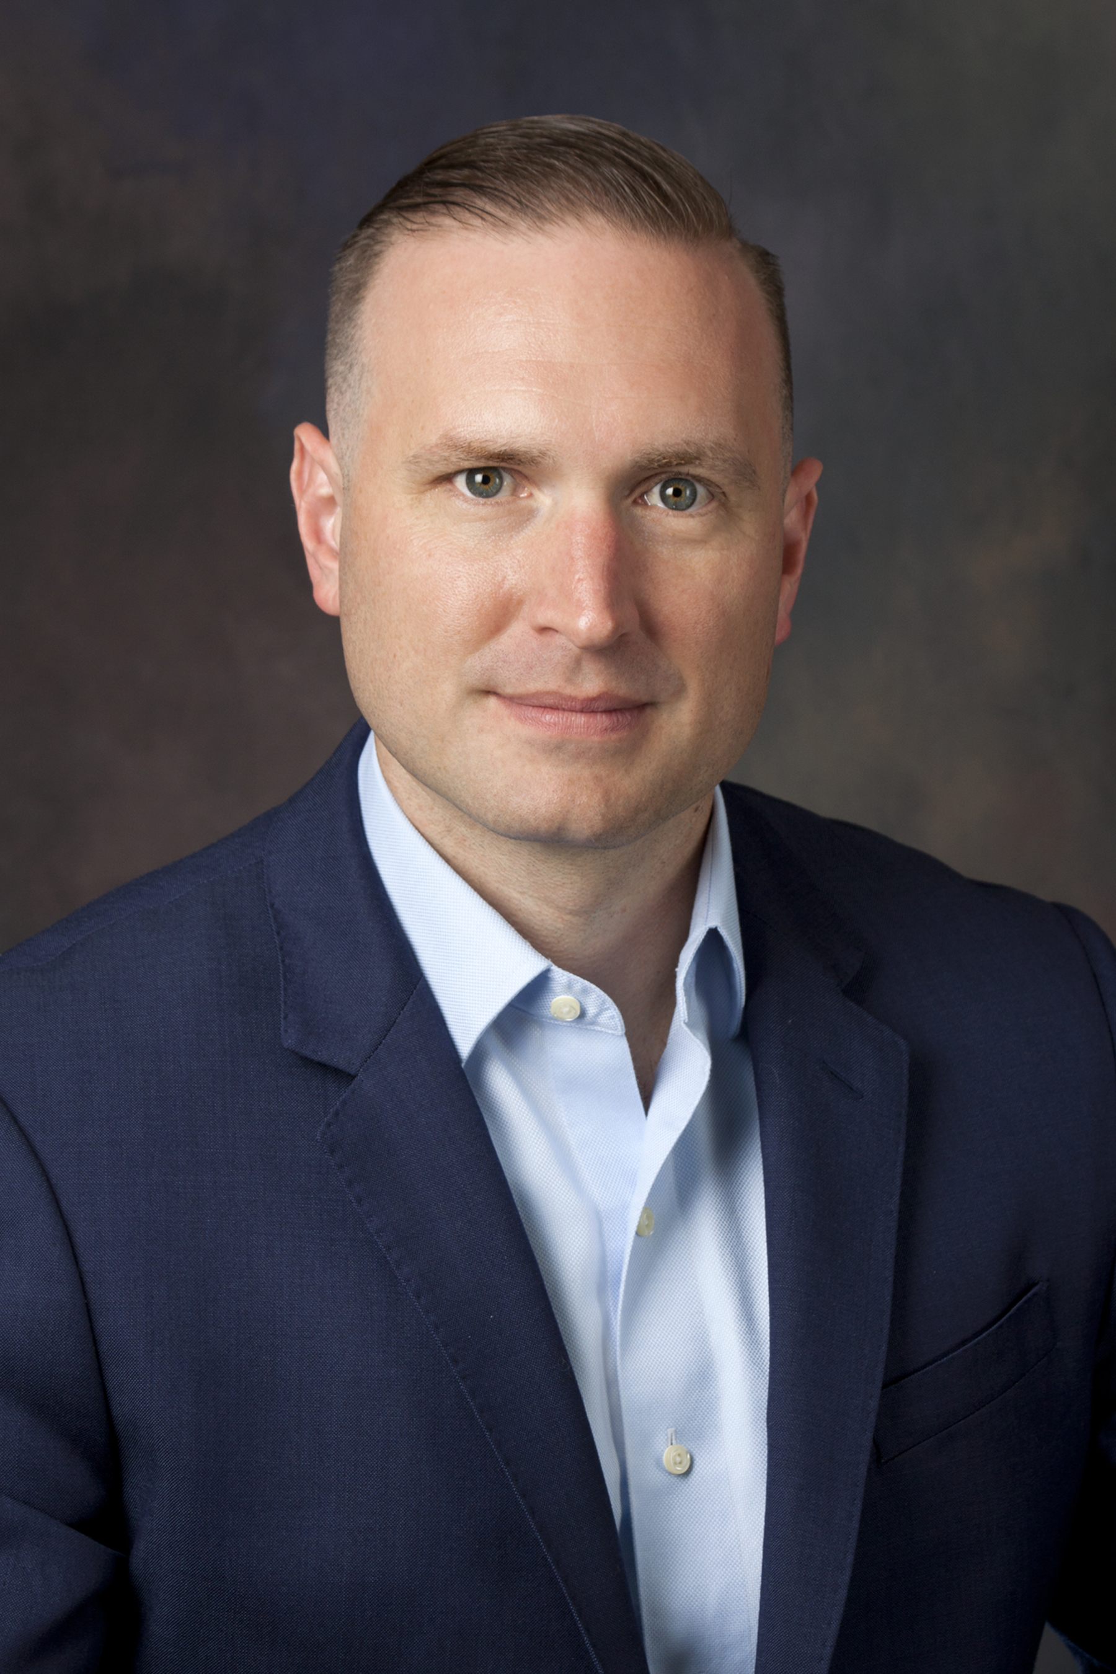
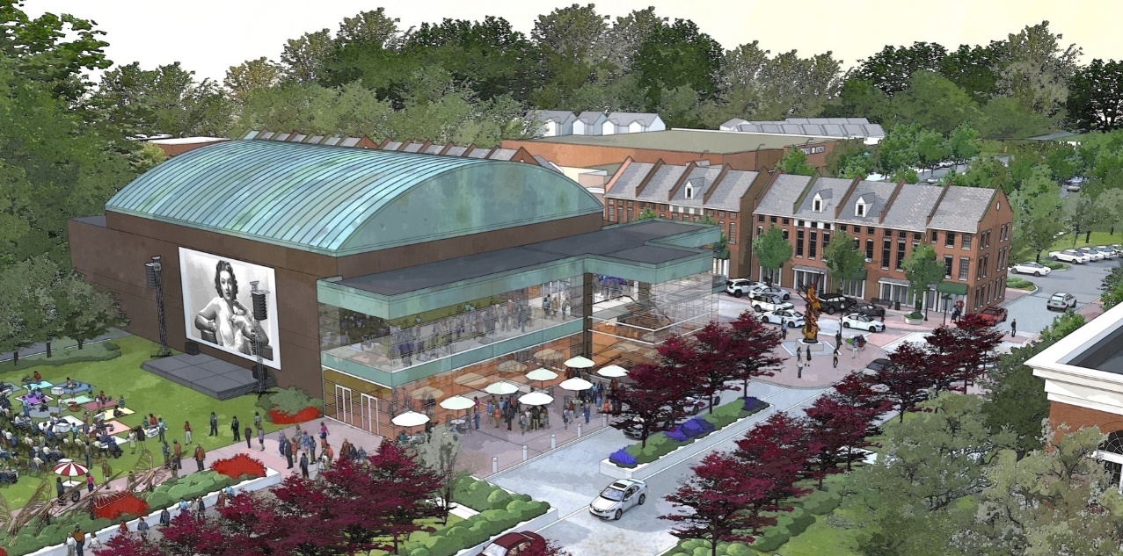
OPENING MESSAGE
The Cain Center for the Arts is a partnership between the Town of Cornelius, NC and a 501(c)3 organization funded in part by $4 million allocated by voters in 2013, the Center will be located on 1.85 acres in Cornelius’s emerging arts district.
Our physical venue will be a regional hub for performance, programming, and partnership. It will serve as a place for the community to gather and as a starting point for initiatives that take the arts out into schools, community centers, places of worship, or anywhere people come together to connect, learn, and enjoy the arts.
Our strategic plan focuses on objectives, organizational designs, and estimated financial projections for 2019 to 2023. This timeframe is particularly critical for us as we will be transitioning from “concept to reality” through the construction of our facility, beginning in Nov. 2019, and the opening of our center, targeted for April 2022.
I want to thank my Board of Directors for their strategic insights and the support of Deloitte Consulting for their research reviews and working sessions to help us in developing this plan.
I am happy to share our plan details over the course of this document and I look forward to the exciting transformation the following years will bring for us and the Lake Norman community.
Justin Dionne
Executive Director
Signature Placeholder
Justin Dionne
The Cain Center for the Arts
A 400 seat theater
Gallery space
Event spaces
Classrooms
A community green space
A warming kitchen
Parking and pedestrian access

Slide 4
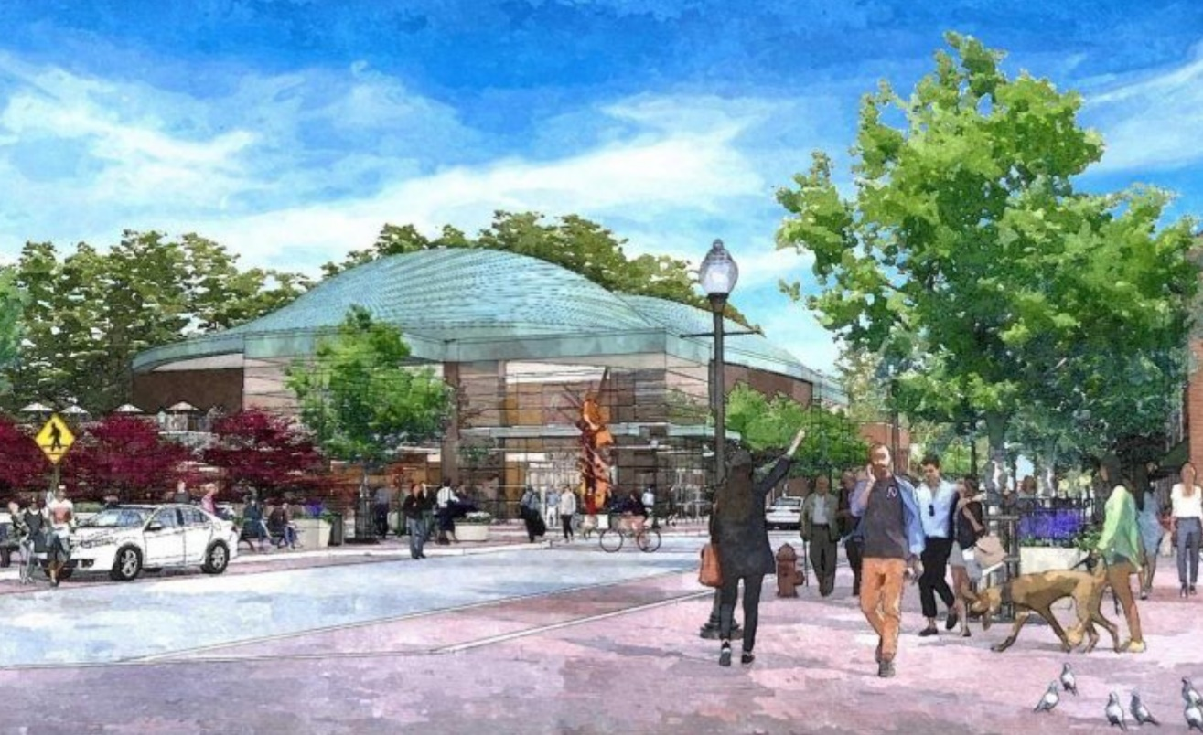
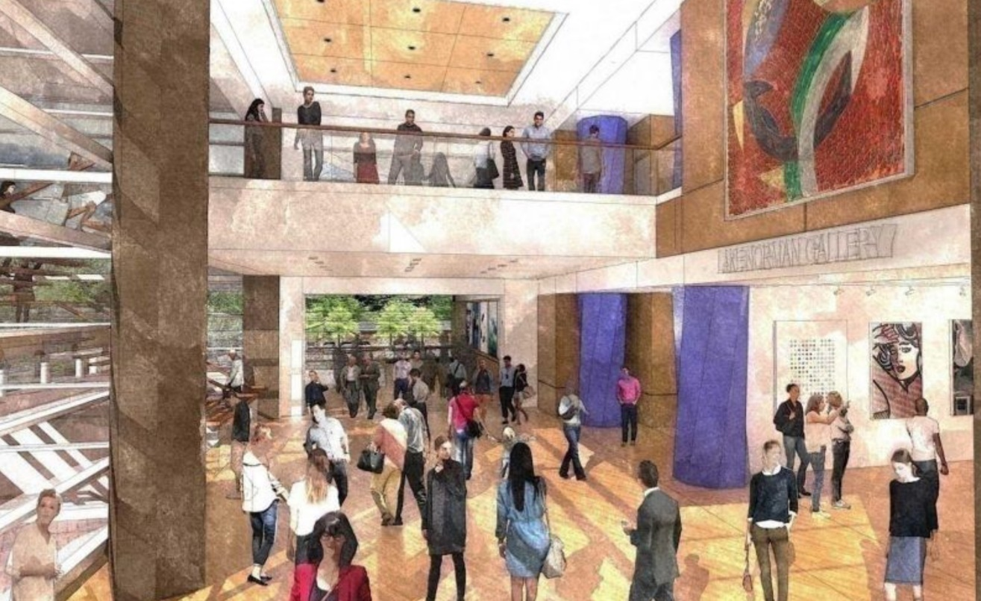
OUR VISION
THE NEED
As the four-county Lake Norman region continues to grow, the need for access to the arts grows too.
As the region’s only public arts and community center, the Cain Center for the Arts will offer performance, education, gallery, and community spaces designed to be beautiful, flexible, and close to home for the more than 300,000 residents of the Lake Norman region.
SERVING THE COMMUNITY
At the Cain Center for the Arts, we’re constructing much more than just a building. We’re creating a stronger community through the power of the arts.
Our vision is simple: we want to empower children and adults alike to create, experience, and enjoy the arts, right here in the heart of the region where they live, work, and play.

Slide 5
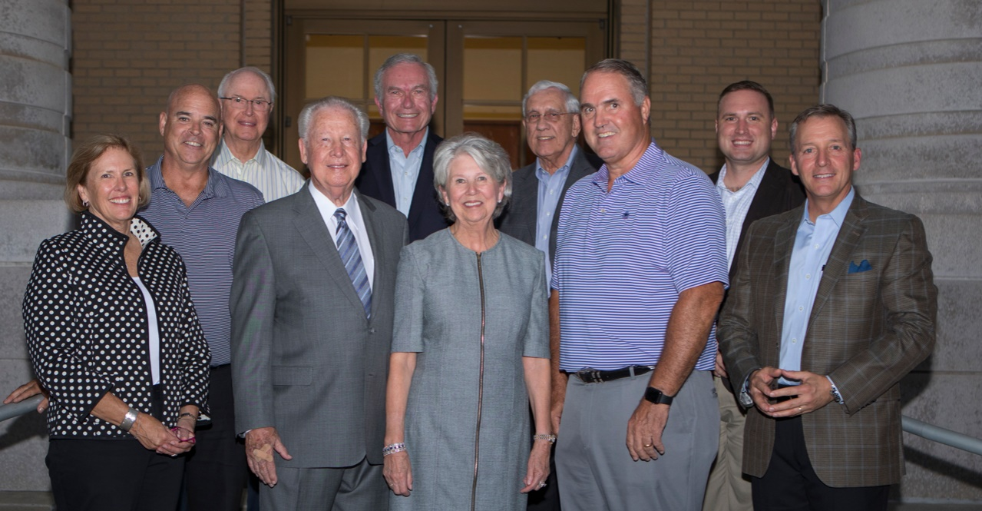
OUR BACKGROUND
2013 Town Center Bond Referendum
Nov. 2015 – Jan. 2017 Strategy and program plan established 501(c)3 created Site purchased
MAY 2017 – July 2018 Executive Director Hired C Design and New York-based Holzman Moss Bottino Architecture engaged; pre-design completed Market study completed Fundraising campaign launched Education strategy and plans in progress
Aug. 2018 - Present Lead gift of $5,000,000 secured Silent phase of campaign in progress, with more than $14 million pledged or contributed to date
OUR HISTORY
In 2013, the Town of Cornelius began to recognize the need for an arts and cultural venue to revitalize and enrich the community through the arts and all the benefits of arts education. As a direct result, the town voted to allocate $4 million out of a $20 million municipal bond to create an arts district and in 2017 invested additional support by purchasing the 1.85 acres where the Cain Center for the Arts will be built.
Through a four-year strategic planning process, conducted by an investigative committee appointed by the Town of Cornelius, a non-profit organization was created to anchor the public-private partnership between the Center and the Town of Cornelius.
Executive Director Justin Dionne was hired in 2017 and in the fall of 2018, the board and leadership launched the quiet phase of a $25 million campaign. A transformational gift from local philanthropists Ericka and Bill Cain led to the center’s permanent name: Cain Center for the Arts.

Slide 6
OUR VALUES
INSPIRATIONAL
To be a center that inspires and encourages creativity.
COMMUNITY-CENTERED
To be a center that serves everyone. To expose, invite, and engage as a destination for all members of the community.
CREATIVE
To service as a hub of creativity, providing a platform for unique and individual expression.
Entertaining
To provide a holistic experience that produces valuable, enjoyable experiences while also focusing on comfort.
EDUCATIONAL
To be a center where the arts and education connect.

Slide 7
OBJECTIVES OVERVIEW
Preparing
2019-2020
Building
2020-2021
Opening
2021-2022
Maturing
2022-2023
Over the course of the next 4 years, the Cain Center for the Arts will build and implement a center that will bring all the benefits, beauty, and joys of the arts together, right in the heart of the Lake Norman region.
Our strategic plan is organized to support this vision through year-by-year objectives centered on:
Preparing for Breaking Ground – to meet / exceed fundraising targets, develop programming strategies, and establish a greater outreach network across the Lake Norman community
Building the Cain Center for the Arts – to establish our physical presence in parallel with developing the program plan, technologies, and community awareness needed for our success
Opening the Cain Center for the Arts – the finalization and deployment of our initial programming while creating a strong community presence through targeted marketing and outreach efforts
Maturing to Embrace the Future – the growth and sustainment of the center to become a sought-after destination for the arts

Slide 8
OBJECTIVES BY YEAR
Preparing
2019-2020
Building
2020-2021
Opening
2021-2022
Maturing
2022-2023
Preparing | Primary focus: completion of the capital campaign for the Cain Center for the Arts facility (funds required for ground-breaking) Meet / Exceed Fundraising Targets Develop Initial Programming Plan Establish an Outreach Network
Building | Primary focus: construction management for the Cain Center for the Arts facility and programming delivery preparation Manage Construction Completion Conduct Community Arts Awareness / Education Implement Technology Requirements Launch Next Wave Marketing and Development Initiatives
Opening | Primary focus: open the Cain Center for the Arts facility and deploy initial programming Scale up Staffing Capitalize on Marketing and Outreach Launch the Center Deploy the Program Strategy
Maturing | Primary focus: scaled deployment of programs and the enhancement of center operations Manage for Brand Growth Become a Sought-After Destination Streamline Operational Management

Slide 9
PREPARING: OBJECTIVE DETAILS
Preparing
2019-2020
Building
2020-2021
Opening
2021-2022
Maturing
2022-2023
Enabling the center to best meet / exceed fundraising targets, developing programming strategies, and establishing a greater outreach network across the community
Objective | Key Actions | Impact
Meet / Exceed Fundraising Targets | Continue the implementation of planned fundraising events and campaigns, including pledged donor follow-ups Plan and execute public campaign to attract entry level donors, including greater mobile and social media efforts (mobile devices accounted for 48% of traffic to nonprofit websites¹) | Fundraising goals met to enable facility ground-breaking
Develop Initial Programming Plan | Create a base-model contract template, including what technologies and set-ups will be supported by the center and what would need to provided and supported by the client Determine price point targets / break even levels and the programming needs to meet financial goals Review the Next Stage Consulting 2017 market study to target potential clients as aligned to community interests and create a plan for client marketing (commission an updated market study for continued program plan guidance including client interests) | Programming plan developed (for opening and first full year) Targeting of potential presenting / rental clients (ready-to-go list for marketing)
Establish an Outreach Network | Create a volunteer coordinator position (an Advisory Board role working in partnership with the Development Associate) Define volunteer needs (what roles / support is needed), initial focus on awareness building (what is the center and its value) Develop a volunteer attraction, onboarding, and management plan 7 of 10 volunteers never come back; engagement can be improved through a focus on value alignment, group / partner activities, cadence of support, and sharing results² | Creating a volunteer network to promote the center
Determine Local Partnerships | Form and launch a taskforce collaboratively with the Town of Cornelius to seek out joint opportunities and ongoing alignment options regarding the Cornelius Arts Center | Developing a business case for joint operation decisioning
¹ M+R, Non-Profit Fundraising Benchmarks Study, 2019
² Harvard Business Review, A Guide to Managing a Volunteer Workforce, 2016
Notes:
https://hbr.org/2016/03/a-guide-to-managing-a-volunteer-workforce
https://mrbenchmarks.com/assets/files/uploads/2019_Benchmarks_Study.pdf

Slide 10
PREPARING: ORGANIZATIONAL DETAILS
Preparing
2019-2020
Building
2020-2021
Opening
2021-2022
Maturing
2022-2023
The current staff of the Cain Center for the Arts includes:
Executive Director
Development Associate
Administrative and Marketing Assistant
The Program Coordinator role (shown in yellow) is planned to be added in 2019 as a part-time resource to develop the program strategy, in partnership with the Executive Director, in preparation for opening in April 2022 and for potential interim programming considerations.
Board of Directors
Executive Director
(Full-Time)
Development Associate
(Full-Time)
Administrative & Marketing Assistant
(Full-Time)
Program Coordinator
(Part-Time)

Slide 11
BUILDING: OBJECTIVE DETAILS
Preparing
2019-2020
Building
2020-2021
Opening
2021-2022
Maturing
2022-2023
Establishing the Cain Center for the Arts facility (physical construction) in parallel with developing opening plans
Objective | Key Actions | Impact
Manage Construction Completion | Monitor regular construction progress, quality, and risks via a designed Construction Committee (including Town of Cornelius representation) Determine if / how the established contingency funds will need to utilized or increased | Meeting the target construction completion date (Dec. 2021) in accordance with budget plans
Conduct Community Arts Awareness / Education | Define awareness goals, target audiences, and potential partnerships (at the town level and in collaboration with related area centers) Develop collateral materials and talking points (engage volunteers – prioritizing social media strategies, physical display at the construction site) | Creating a “buzz” about the center, attracting donors, volunteers, and clients
Implement Technology Requirements | Define technology needs (e.g., Projection, Sound, Lights, Box Office, Customer Relationship, Back-Office Programs, etc.) Research (comparisons, references) and select vendors, document system trainings for future staff knowledge transitions | Having an operational ticketing platform, and related technologies / tools for program and service management
Launch Next Wave Marketing and Development Initiatives | Develop an approach to track the economic and community impacts of the center (to demonstrate value to donors) Create the communication strategy (to shift the Centers’ requests from construction to evolution) Align campaign objectives to annual fundraising targets, investment needs, and expense gaps Determine long-term investment strategies | Completing the Capital Campaign and transitioning to an ongoing fund for center sustainment and innovation

Slide 12
BUILDING: ORGANIZATIONAL DETAILS
Preparing
2019-2020
Building
2020-2021
Opening
2021-2022
Maturing
2022-2023
The Development Associate role transitions to a Development and Marketing Director accountable for all sales and fundraising activities.
The Administrative and Marketing Assistant role shifts to a Marketing & Development Associate for greater dedication to sales / marketing and outreach support, reporting to the Development and Marketing Director.
A part-time role is added as an Office Assistant, taking over the former administrative duties from the past Administrative and Marketing Assistant role.
Board of Directors
Executive Director
(Full-Time)
Development and Marketing Director
(Full-Time)
Office Assistant
(Part-Time)
Program Coordinator
(Part-Time)
Marketing & Development Associate
(Full-Time)

Slide 13
OPENING: OBJECTIVE DETAILS
Preparing
2019-2020
Building
2020-2021
Opening
2021-2022
Maturing
2022-2023
The finalization and deployment of the Cain Center for the Arts initial programming and the creation of a community presence through targeted marketing and outreach efforts
Objective | Key Actions | Impact
Scale Up Staffing | Refine role responsibilities and develop job postings (promoted via traditional postings, social media, and the volunteer network) Hire for staff and management positions (hiring management up to 6 month prior to opening and general staff up to 4 months prior to opening) | Resourcing is in place to open the center and deliver on the programming strategy
Capitalize on Marketing and Outreach | Complete outreach to targeted vendors / partners, place paid ads for key gaps Convert ongoing awareness and fundraising channels into client marketing sources | Bookings of programs / rentals have been secured
Launch the Center | Define and prepare for Day One – dedicated opening campaign with a relatable theme for initial programming Provide visual sponsorship / donor recognition and gratitude Conduct regular staff lessons learned sessions (appreciation and development focused) for a quality workplace culture | Opening of the center with high-customer draws and appreciation shown for supporters (staff and donors)
Deploy the Program Strategy | Coordinate fixed and variable bookings (as per opening timeline) Establish a quality delivery protocol (checklist and contingencies) | Executing of the program strategy with a quality focus

Slide 14
OPENING: ORGANIZATIONAL DETAILS
Preparing
2019-2020
Building
2020-2021
Opening
2021-2022
Maturing
2022-2023
The Program Coordinator role transitions to a full-time General Manager & Program Lead role to be accountable for the overall programming strategy and delivery management.
Two new full-time roles are added in preparation for opening:
Box Office / Front-of-House Manager to oversee all ticketing operations
Technical / Building Operations Director to oversee center technologies and day-to-day operations for programing support and rental management
Additional part-time roles are added for center operational delivery; Customer Service Representative and Light / Sound Technicians.
All changes from 2020 to 2021 are shown in yellow.
Board of Directors
Executive Director
(Full-Time)
Development and Marketing Director
(Full-Time)
Office Assistant
(Part-Time)
General Mgr & Program Lead
(Full-Time)
Technical / Building Operations Director
(Full-Time)
Box Office / Front-of-House Manager
(Full-Time)
Marketing & Development Associate
(Full-Time)
Light / Sound Technicians
(Part-Time)
Customer Service Rep
(Part-Time)

Slide 15
MATURING: OBJECTIVE DETAILS
Preparing
2019-2020
Building
2020-2021
Opening
2021-2022
Maturing
2022-2023
Managing the growth and sustainment of the Cain Center for the Arts to become a sought-after destination for the arts across Lake Norman and the Carolinas
Objective | Key Actions | Impact
Manage for Brand Growth | Formalize means for client and customer feedback collection Analyze and review data for opportunities to increase client and customer satisfaction Create key client development plans (for mutual benefit – to increase their bookings / revenue) Conduct staff and volunteer developmental discussions to align to best-fit opportunities | Developing a reputation as a center that clients, customers, and staff respect
Become a Sought-After Destination | Seek out partnership opportunities beyond the Lake Norman areas Explore opportunities for state level funding and arts / education program alignment Increase the scope of outreach campaigns and marketing with partners and state-level programs to increase client and donor attraction | Expanding the support of the center beyond the Lake Norman area
Streamline Operational Management | Understand staff time allocations to client value drivers – realigning roles from generalist to specialists (maximizing staff and volunteer roles for the maturing center) Review Board positions and composition to reevaluate for post opening support needs | Enhancing day-to-day management and delivery effectiveness

Slide 16
MATURING: ORGANIZATIONAL DETAILS
Preparing
2019-2020
Building
2020-2021
Opening
2021-2022
Maturing
2022-2023
The office assistant role transitions from part-time to a full-time Office Manager role due to the increased staff and center support needed.
A new part-time role, Community Engagement Associate, is added to support community partnerships / volunteer networks.
All changes from 2021 to 2022 are shown in yellow.
Board of Directors
Executive Director
(Full-Time)
Development and Marketing Director
(Full-Time)
General Manager & Program Lead
(Full-Time)
Office Manager
(Full-Time)
Technical / Building Operations Director
(Full-Time)
Box Office / Front-of-House Manager
(Full-Time)
Marketing & Development Associate
(Full-Time)
Community Engagement Associate
(Part-Time)
Light / Sound Technicians
(Part-Time)
Customer Service Rep
(Part-Time)

Slide 17
FINANCIAL PROJECTIONS
Financial projections have been included for directional strategic planning purposes only and do not constitute audited or guaranteed revenue or expense amounts.
Projections have been based on comparable market research and planned initiatives, financial details will be monitored with projections adjusted as per evolving details.
 | Preparing 2019-2020 | Building 2020-2021 | Opening 2021-2022 | Maturing 2022-2023
Revenue
Earned | $ 0k | $ 0k | $ 180 to 215k | $ 530 to 645k
Contributed - Government | $ 325k | $ 330k | $ 335k | $ 340k
Contributed - Fundraising | $ 20k | $ 100 to 175k | $ 210 to 275k | $ 335 to 385k
Total Revenue | $ 345k | $ 430 to 505k | $ 725 to 825k | $ 1.2 to 1.4M
Expenses
Labor | $ 260k | $ 310 to 385k | $ 420 to 520k | $ 520 to 685k
Programming | $ 0k | $ 0k | $ 145k | $ 435k
Admin / Other | $ 85k | $ 120k | $ 160k | $ 250k
Total Expenses | $ 345k | $ 430 to 505k | $ 735 to 825k | $ 1.2 to 1.4M
Net | $ 0 | $ 0 | $ 0 | $ 0
Definitions
Earned Income: Refers to all income gained through ticket sales, facility rentals, or concessions
Contributed – Government: Income gained through State, City/County, or related sources
Contributed – Fundraising: Income gained through individuals, corporations, grants, or other sponsorship programs
Labor – Personnel related expenses including salaries, benefits, and payroll taxes
Programming – Expenses for marketing and delivering performances, classes, exhibits, facility rentals, concessions, and others related programs / services
Administrative / Other – All other expense items such as technology, accounting, communications, lability insurance, office supplies, marketing, etc.

Slide 18
STAFF AND BOARD OF DIRECTORS
Cain Center for the Arts Staff
Justin Dionne
Executive Director
Allison Elrod
Development Associate
Anita Overcash
Administrative & Marketing Assistant
Board of Directors
Greg Wessling President The Lake Norman Company | Joshua Dobi North Main Financial Group | Bill Morgan Morgan Associates
Pat Bechdol Vice President Deloitte Consulting (retired) | Jim Duke Federal Executive (retired) | Caroline Mullan Community Volunteer
Troy Stafford Treasurer Devore, Acton & Stafford, P.A. | Kate Gaither Newport Properties | Paul Newton Newton Construction Services
Cynthia Bush Secretary UNC Charlotte Faculty Member | Ginger Griffin Ginger Griffin Marketing & Design | Janice Travis IBM Global Services Consulting (retired)
Denis Bilodeau Commissioner – Town of Cornelius | Donna Johnson Community Volunteer | Woody Washam Mayor – Town of Cornelius
Steve Brumm Brumm Properties

Slide 19
OUR PATH FORWARD
WE’RE BUILDING SOMETHING EXTRAORDINARY
Over the next four years, the Cain Center for the Arts will evolve from artistic renderings to a physical presence that will feature national touring companies and world-renowned entertainers to local productions and grassroot performers.
We will complete our capital campaign and break-ground on the Cain Center for the Arts facility
We will be managing the construction of the center, building awareness, and preparing for program delivery
We will be opening our doors to the public and deploying our initial programming
We will be delivering our first full-year of programming and scaling / enhancing our operations
Our planned objectives driven by our identified roles / structure will enable the Cain Center for the Arts to bring the benefits, beauty, and joys of the arts together in the heart of the Lake Norman region.
Preparing
2019-2020
Building
2020-2021
Opening
2021-2022
Maturing
2022-2023

Slide 20
APPENDIX I
Revenue and Expense Details

Slide 21
Expenses: Labor Estimate Details
Role | Part / Full Time | Preparing 2019-2020 | Building 2020-2021 | Opening 2021-2022 | Maturing 2022-2023
Executive Director | FT | 105k | 108k to 140k | 111k to 140k | 115k to 140k
Development Associate | FT | 50k | 60 to 75k (Director) | 60 to 75k (Director) | 60 to 75k (Director)
Administrative & Marketing Assistant | FT | 42k | See Mkg& Dev. Associate | -- | --
Program Coordinator | PT | 30k | 32k to 40k | 32k to 40k | See GM
Box Office / FOH Manager | FT | -- | -- | 18 to 23k | 35 to 45k
Technical Director & Building Operations | FT | -- | -- | 30 to 38k | 60 to 75k
Customer Service Rep. | PT | -- | -- | 7 to 8k | 20 to 25k
Light Technician | PT | -- | -- | 5 to 8k | 15 to 25k
Sound Technician | PT | -- | -- | 5 to 8k | 15 to 25k
General Manager | FT | -- | -- | 28 to 33k | 55 to 65k
Office Manager | PT/FT | -- | 25 to 30k | 25 to 30k | 35 to 40k
Marketing and Development Associate | FT | -- | 45 to 50k | 46 to 52k | 46 to 54k
Community Engagement | PT | -- | -- | -- | 25 to 30k
Labor Salaries |  | $ 227k | $ 270 to 335k | $ 368 to 455k | $ 481 to 599k
Benefits * |  | $ 16k | $ 19 to 24k | $ 27 to 32k | $ 35 to 43k
Payroll Taxes (7.65%) |  | $ 17k | $ 20 to 26k | $ 28 to 34k | $ 37 to 46k
Summary
2019-2020: Addition of the Program Coordinator role as a part-time resource
2020-2021: Transition of the Development Associate to a Director role, Marketing role becomes full-time, with a part-time Office Assistant added
2021-2022: Two new full-time roles added (Tech/Ops Dir. and Box Office) and part-time staff brought on for light, sound, and customer services (assumes mgr roles at 6 months, others at 4 months)
2022-2023: New full-time role of General Manager, Office role becomes full-time, and a new part-time role for community engagement is added
Reference Notes:
New position salaries ranges based on a review of ~200 NC based roles with similar titles (publicly available data via Monster.com and Career Builder)
2020-2021 increases as per current budget plans with 3% year-over-year salary increases thereafter
Any bonuses would be in addition to the projected amounts shown
Benefits are estimated at 7.2% of salaries; a competitive benefits study is recommended for longer-term alignment:
* If using 25% estimate:
Payroll Taxes are estimated at 7.65% of salaries
$ 57k | $ 68 to 84k | $ 91 to 114k | $ 120 to 150k

Slide 22
Expenses: Administrative / Other
Category | Preparing 2019-2020 | Building 2020-2021 | Opening 2021-2022 | Maturing 2022-2023
Accounting & Payroll | 22k | 31k | 35k | 42k
Tax Preparation | 4k | 5k | 6k | 7k
Audit | 7k | 9k | 10k | 12k
Expenses and Reimbursements | 9k | 12k | 14k | 16k
Communications - Phone | 4k | 5k | 6k | 7k
Office Supplies | 2k | 3k | 3k | 4k
Technology/Software | 3k | 4k | 5k | 6k
Memberships / Dues | 2k | 3k | 3k | 4k
Liability Insurance | 2k | 3k | 3k | 4k
Board Meeting Expenses | 3k | 3k | 3k | 4k
Board and Officers / Workers Compensation | 1k | 1k | 1k | 1k
Marketing and Development Expenses | 25k | 28k | 60k | 120k
Fundraising Expenses | 0k (via campaign) | 9k | 11k | 23k
Administrative / Other Total | $ 84k | $ 118k | $ 162k | $ 250k
Reference Notes:
Items based on the 2019-2020 Cain Center for the Arts budget
Directional assumption that all expenses will increase as the size and complexity of the Cain Center for the Arts continues to grow – projecting rate increases scaled to the percentage of labor cost increases
Marketing and Development (based on Cain Center for the Arts SME insights)
Fundraising expenses estimated at ~7% of the fundraising target
Cain Center for the Arts - Strategic Plan

Slide 23
Revenue & Expenses: Programming
Category | Opening 2021-2022 | Maturing 2022-2023 | Nationwide Average
Revenue
Programming Income | 94 to 114k | 280 to 343k | 690k
Facility Rental Income | 47 to 57k | 140 to 171k | 163k
Concessions Income | 36 to 44k | 108 to 132k | 126k
Education / Outreach Program Income | -- | -- | 94k
Income Sub-Total | $ 177 to 215k | $ 528 to 646k
Expenses
Programming Fees | 110k | 330k | 380k
Facility Expenses | -- | -- | 56k
Concessions Expenses | 35k | 106k | 106k
Education / Outreach Program Expenses | -- | -- | 76k
Expenses Sub-Total | $ 145k | $ 436k
Reference Notes:
Nationwide averages based on studies by the Theatre Communications Group, income and expense items shown for areas most applicable to the Cain Center for the Arts (in terms of peer groups)
Assumes that 2022 to 2023 will be the first full year of programming delivery, with 2021 to 2022 as a partial year of program delivery (estimated at 33% of a full year)
Income is based on working sessions with the Cain Center for the Arts Executive Director for the initial programming strategy (number / types of programs)
Conservative estimates were used, based on survey results from the Theatre Communications Group, on average theatres operate with 62% paid capacity; for the Cain Center for the Arts a range of 50% to 70% has been used
A review of local facility rental competition was conducted and the income estimate was found to be in-line with Theatre Communications Groups’ nationwide averages
Program Fees: Includes contract fees, general non-payroll artistic fees (travel / accommodations), and any non-contract stage or visual display management/supplies
Facility Expenses: Expenses related to maintenance would be managed via the Town of Cornelius; (Board discussion item: would all utilities be covered by the Town of Cornelius)
Education / Outreach Programs: No income or expenses are shown as the Cain Center for the Arts focuses on a presentation / rental strategy, however any joint operations with local groups (e.g. Cornelius Arts Center) would impact these areas
Cain Center for the Arts - Strategic Plan

Slide 24
Revenue: Contributed Income
Category | Preparing 2019-2020 | Building 2020-2021 | Opening 2021-2022 | Maturing 2022-2023
Town of Cornelius Appropriation Request | 323k | 329k | 336k | 343k
Grants | -- | 25k | 28k | 30k
Fundraising / Sponsorships | 15k | 100 to 175k | 182 to 247k | 305 to 355k
Contributed Income Total | $ 338k | $ 454 to 529k | $ 546 to 611k | $ 648 to 698k
Reference Notes:
Town of Cornelius appropriation request remains consistent overtime with an estimated 2% year-over-year inflation
Support may be reduced over time if decided, with any balance to the estimated support level shifted to be covered by either Fundraising or Earned Income
Town of Cornelius is assumed to cover all maintenance related expenses with the related funding and expense figures excluded from these projections (net zero)
Grants are estimated as per Cain Center for the Arts 2019 to 2021 budget planning with 10% target increases for both 2021-2022 and 2022-2023
Fundraising / Sponsorships targets for 2021 and beyond are estimated as per the gap to resolve all projected negative balances
Investment income / endowments are not include in the projections and should be considered as per Cain Center for Arts financial planning for post Construction Capital Campaign actions
ASC tax impacts are not included within the financial projections

Slide 25
APPENDIX II
Cornelius Center for the Arts Details

Slide 26
Expenses and Revenues: Cornelius Arts Center
EXPENSE | FY 2018 ACTUALS
SALARIES-FULL TIME | $ 49,686
SALARIES-PART TIME | $ 27,859
401K-NON SWORN | $ 2,447
FICA | $ 5,690
RETIREMENT | $ 3,731
INSURANCE BENEFITS-HEALTH | $ 6,262
STATE UNEMPLOYMENT | $ 19
PROGRAM SUPPLIES | $ 18,370
TELECOMMUNICATIONS | $ 1,105
ELECTRIC | $ 9,690
BUILDING MAINT | $ 6,596
EXTERNAL PROMOTIONS | $ 1,587
BUILDING RENT | $ 55,320
CONTRACT SVCS | $ 80,501
EXPENSE TOTAL: | $ 268,863
REVENUE: | $ 163,637
NET: | $ (105,226)
Example Opportunities
Pricing Optimization: Example of a first year change of +15% (to be closer to market prices of 30%+)
Increased Hours: Example of longer evening and weekend hours to increase rental and classroom utilization options by up to 40%
Reference Notes:
Source: PARC Cornelius Arts Center program FY18 budget
A separate CAC / Cain Center for the Arts alignment task force is recommended to evaluate a combined services opportunity and develop a business case and go-forward plan

