Slide 1
December 9, 2019 Board Meeting

Slide 2
November Pledge Activity
Cashion pledge agreement complete
15 new pledges totaling additional $217,250 (goal was $100k)
Pledge receivables equal $3,246,149.34
103 Founders’ Society members! William and Sherry Augustine were #100

Slide 3
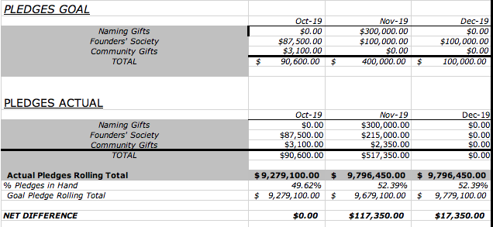
3 Month Snapshot – Pledges

Slide 4
Community Gifts Are:
Contributions from Local and Regional Corporations and Small Businesses
Contributions to the Brick Campaign
All other Non-Founders’ Society Gifts

Slide 5
November Cash Activity
27 payments totaling $227,917.67

Slide 6
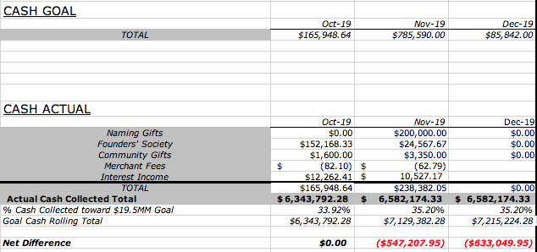
3 Month Snapshot - Cash

Slide 7
Campaign Activity – Expenses
Total Campaign Administrative Expenses to Date: $159,085.89
Total Construction Expenses to Date: $836,472.77
Total Transaction Fees to Date: $1,355.51

Slide 8
Campaign Activity – Expenses

Slide 9
$ 10,527.17
Interest Income
November earnings equal $10,527.17
Cumulative earnings equal $104,807.94

Slide 10
I. Annual Fund Activity
1 Board member made a contribution of $1,000

