Slide 1
January, 2020
Board Meeting

Slide 2
December Pledge Activity
21 new pledges totaling $187,600 on a $100,000 goal
Total Founders’ Society members – 115 (12 new in December)

Slide 3
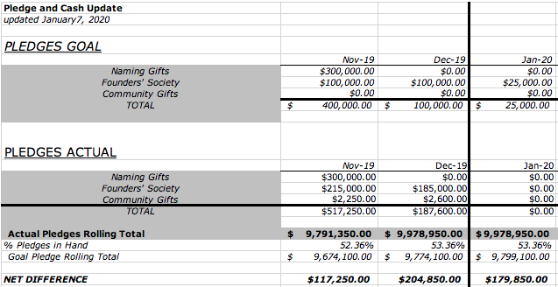
3 Month Snapshot – Pledges

Slide 4
FINAL QUARTER OF 2019:
TOTAL NEW PLEDGES OF
$495,450
does not include naming gifts

Slide 5
December Cash Activity
24 payments totaling $912,273.65

Slide 6
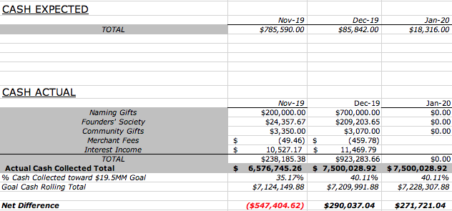
3 Month Snapshot - Cash

Slide 7
2020- The Campaign Ahead
Left to Raise: $9,521,050
Naming Gifts: $8,000,000
Community Gifts: $1,500,000
  Includes Brick Campaign $500,000
  Local Businesses and Families/Individual $1,000,000

Slide 8
2020 Strategies
Leadership

Slide 9
Campaign Leadership
Campaign Chair – Pat Bechdol
Naming Gifts
$8MM
Chair: Woody Washam
Staff: Justin
Community Gifts - $1.5MM
Campaign Support
Chair: Bill Morgan
Staff: Allison/Anita
Marketing/PR: Staff
Stewardship: Christian Burns
Event Planning/Assistance:
Finance: Jim Duke
Tools:
Volunteers
Events
Local/Regional Business
Chair: Joshua Dobi
Staff: Justin
Individuals & Families
Chair: Cynthia Bush
Staff: Allison
Team:
Tools:
Founders Society
Paver Campaign
Mobile Giving
Neighborhood Cptns
Events
Team:
Greg Wessling
Woody Washam
Pat Bechdol
Troy Stafford
Tools:
Naming Opportunities
Founders Society
Direct Ask
Team:
Amy Lykins
Scott Rothenberg
Tools:
Naming Opportunities
Founders Society
Events
Mobile Giving
First Meeting: January 17

Slide 10
2020 Strategies
Marketing and Public Relations

Slide 11
2020 Strategies
Marketing Team:
Ginger Griffin Marketing and Design
Graphic Design Strategy and Execution
Brochures
Display
Website
Newsletters
Brick Campaign Collateral
Invitations
Campaign Branded Giveaways
Signage

Slide 12
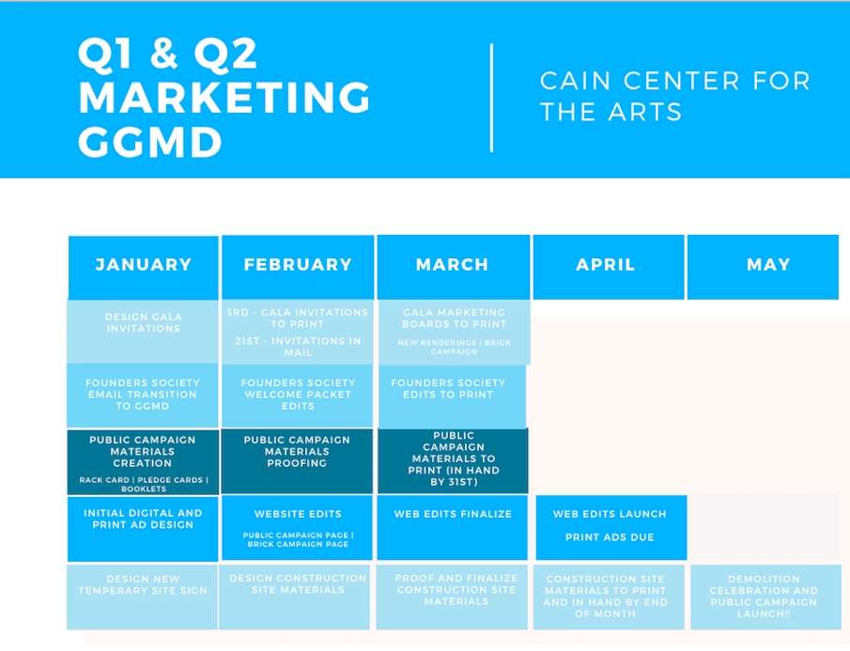

Slide 13
2020 Strategies
Marketing Team:
Ginger Griffin Marketing and Design
Graphic Design Strategy and Execution
Wheelhouse Media
Digital Content Strategy and Execution
Video
Social Media Content
Content To Elevate and Integrate with GGMD

Slide 14
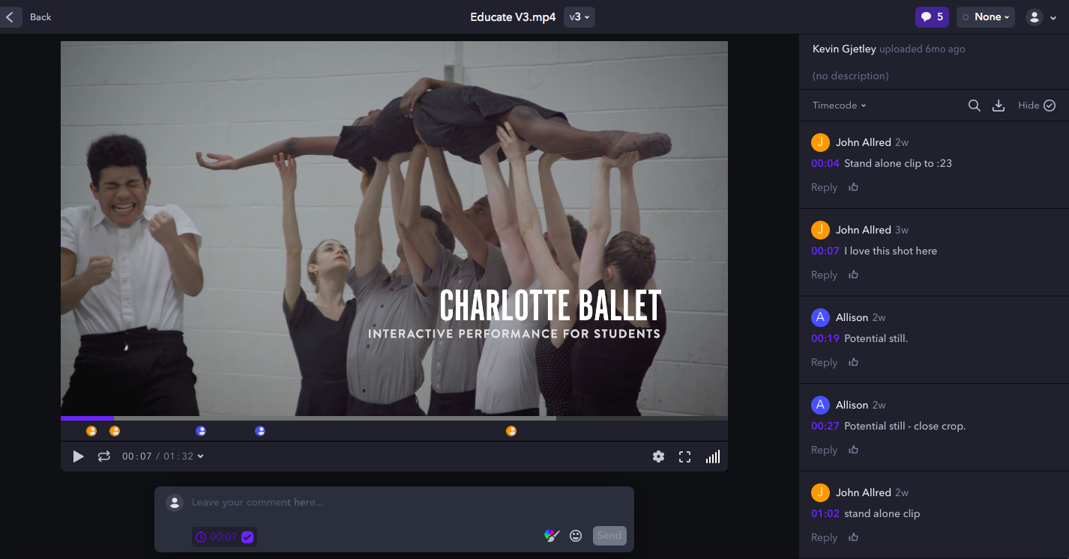

Slide 15
2020 Strategies
Marketing Team:
Ginger Griffin Marketing and Design
Graphic Design Strategy and Execution
Wheelhouse Media
Digital Content Strategy and Execution
Video
Social Media Content
Content To Elevate and Integrate with GGMD
Staff
Brand Champions
Campaign Messaging
Public Relations Strategies
Project Management

Slide 16
2020 Strategies
Events

Slide 18
”Porch Parties”
3 couples for drinks and conversation with member of staff
Lunch for 8 at a club or local restaurant
Dinner party in your home or at club or restaurant
Purpose: Create urgency, close your ask

Slide 19
2020 Gala – Friday, April 3
Woody and Sharon Washam Chairs
Committee Members:
  Della Stafford
  Vickie VanWingerden
  Joy Evans
  Meredith Fite
Budget set
Preliminary meeting with Peninsula Club
Invitation in predesign

Slide 20
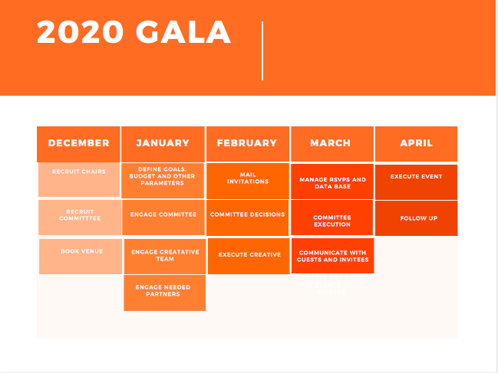

Slide 21
Board Leadership
Build on your success
Cultivate your prospects
Add to your prospect list
Communicate with your prospects
  Monthly email
  Founders’ Society newsletter
Give us names to add to the Gala invitation list
Get dates on the calendar for porch parties
Communicate with Development Team

Slide 22
Naming Opportunities

