Slide 1
Cornelius Arts District

Slide 2
Town Board tasked the Planning Board with study and planning efforts related to the development of an arts district in Cornelius to support the Cain Center for the Arts.
Town Planning Staff is already working with developers who are speculatively buying property in anticipation of developing uses that will complement and support the Cain Center.
Town’s goal was to conduct a planning effort that would put us ahead of private planning efforts in order to achieve a more cohesive and dynamic district that would support the Cain Center.

Slide 3
The Planning Board established three primary targets in the planning effort:
District boundary
Land Use Plan and Zoning
Event planning and support

Slide 4
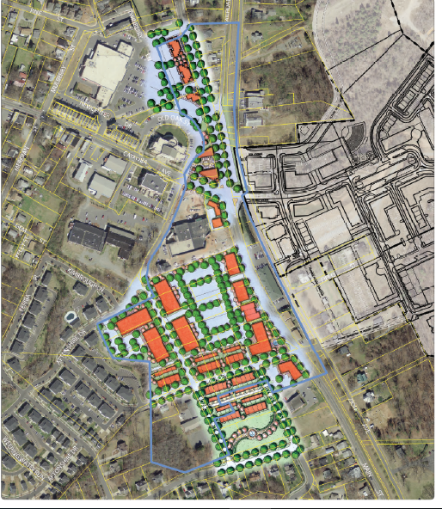
District Boundary

Slide 5
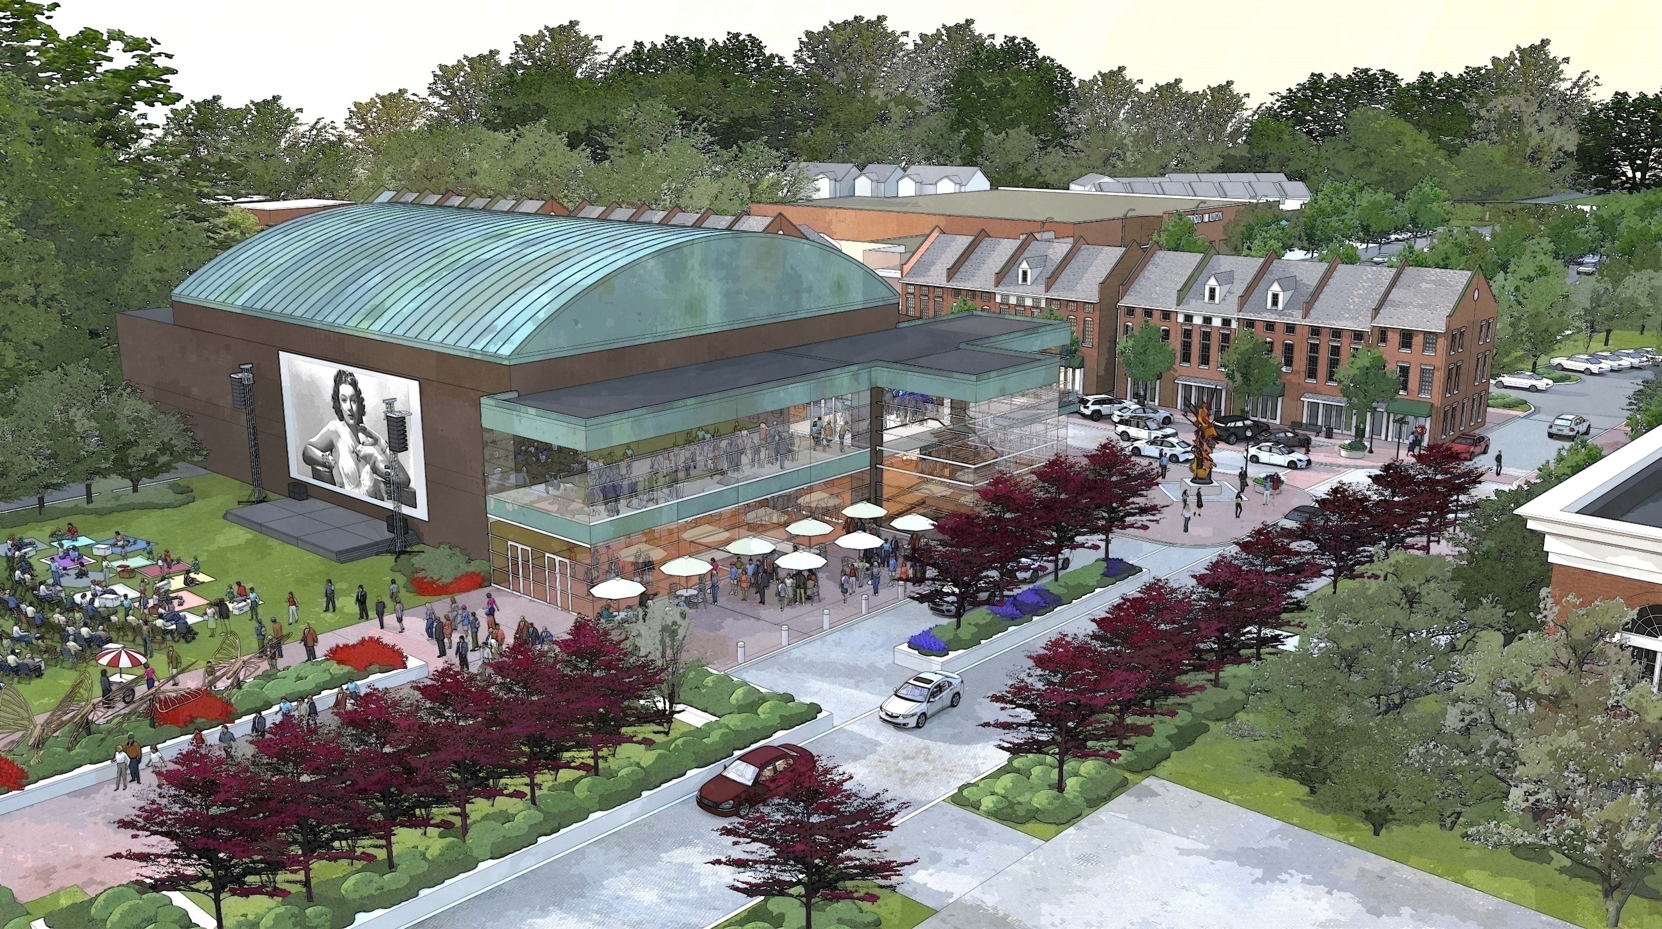
District Boundary

Slide 6
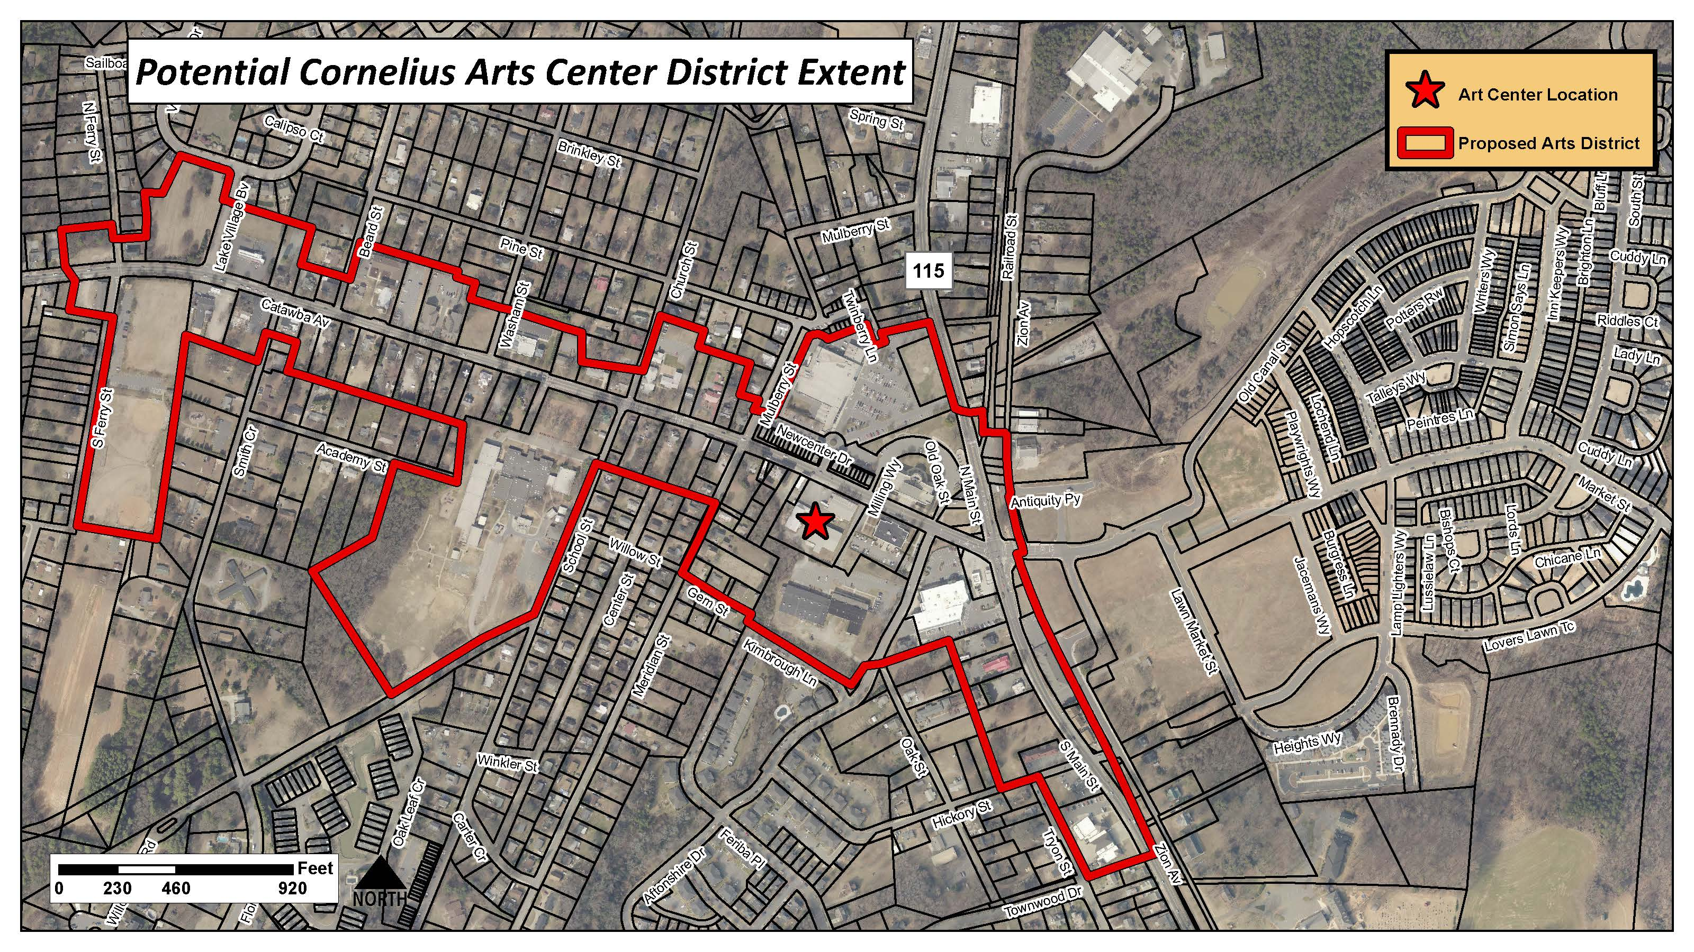
District Boundary

Slide 7
Land Use Plan and Zoning

Slide 8
Land Use Plan and Zoning
Recommending certain uses not be allowed in district: funeral homes, kennels and similar uses that do not promote entertainment and the arts.
Recommending that residential density and mixed uses be evaluated. Increases in mixed use residential densities would be a an economic driver for arts district success.
Recommendation for all development to contain one or more forms of art, ie: murals, statues, etc.

Slide 9
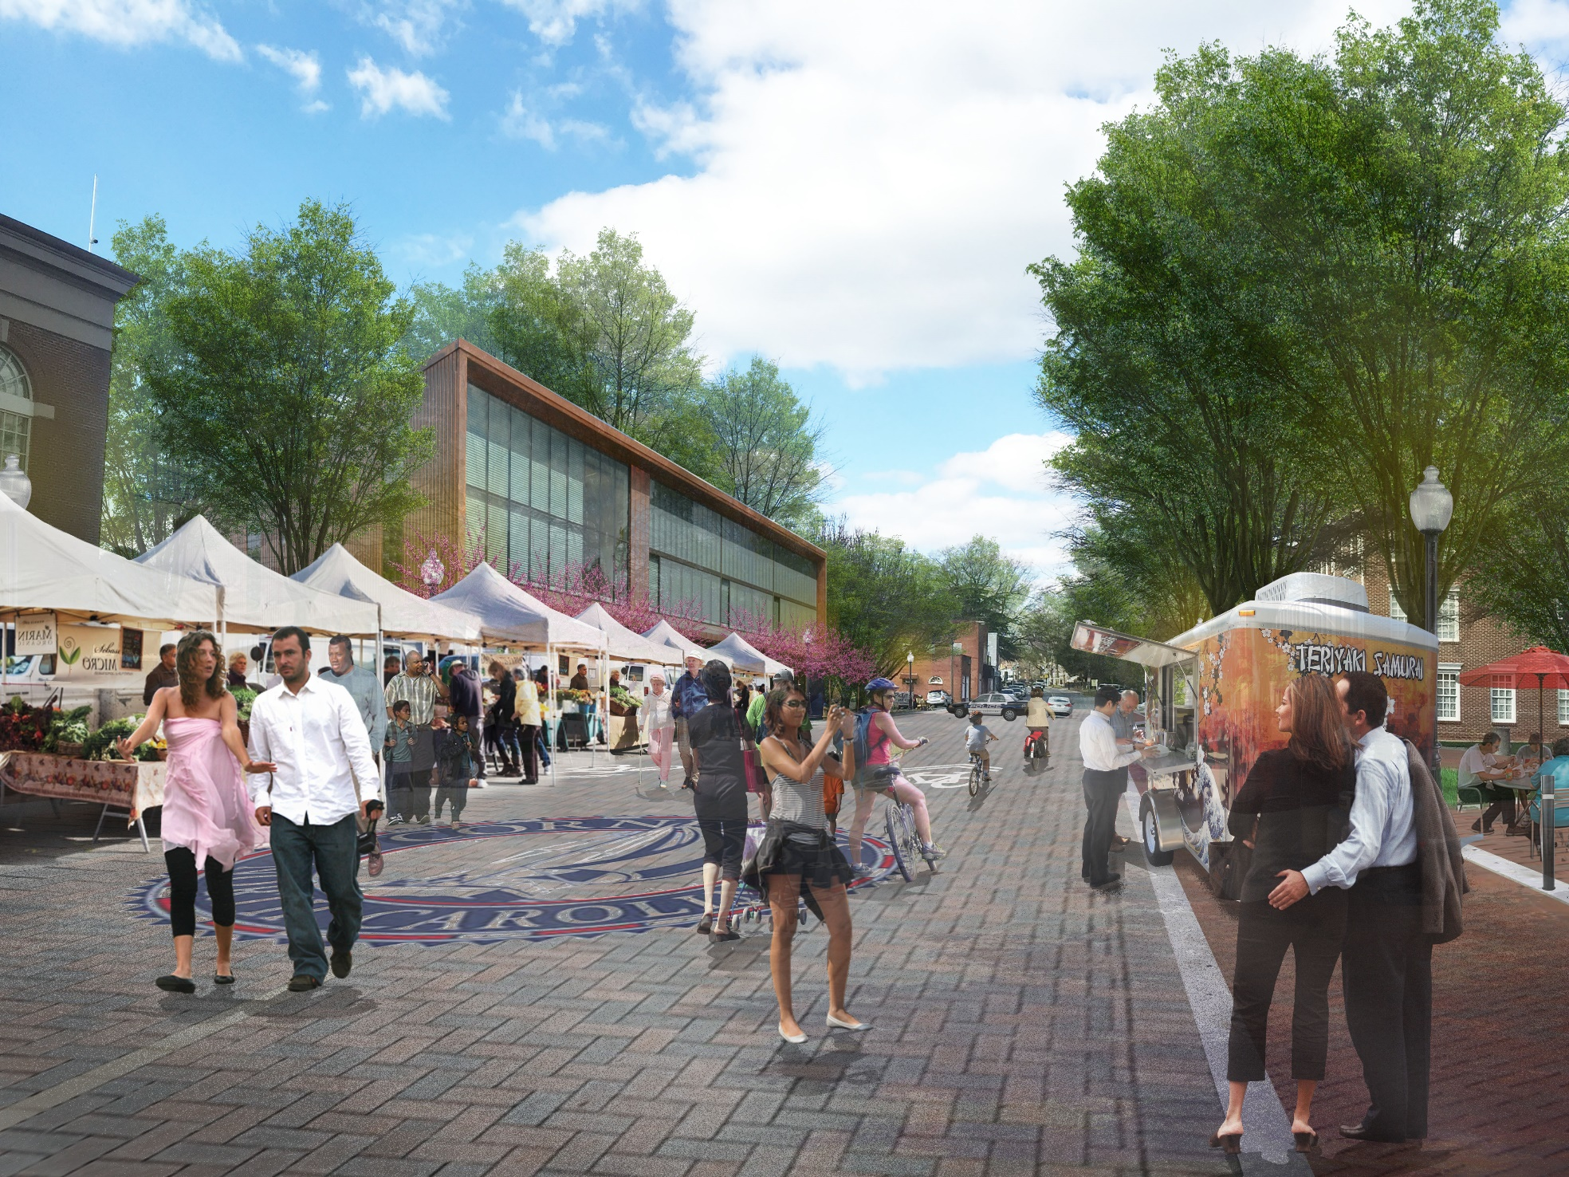
Event Planning & Support

Slide 10
Planning Board is researching and studying existing downtown organizations throughout the State of North Carolina and the Nation. Many successful models.

Slide 12
Parking and Traffic
Town contracted with Kimley Horn(KH) in August 2018 to conduct a parking and Traffic Study
KH determined that adequate publicly owned parking did physically exist in the proximity of the proposed Cain Center to support the programming being discussed.
Additional parking in close proximity would be preferred.
Town is currently negotiating an economic development agreement with a developer that could include a parking structure.
With regard to traffic and congestion, success is based on the timing of programs and reduced conflict with prime congestion times.

Slide 13
Parking and Traffic
The Cain Center and the Town must work together on an event egress plan guide and schedule, much the same as all entertainment venues have, ie: Charlotte Motor Speedway, Spectrum Center, BB&T Ballpark.
The event egress plan would identify how signals may be controlled, directional egress depending on parking location, persons to direct traffic and pedestrians, etc.

