Slide 1
Executive Director Report
February 2020

Slide 2
Q1 Strategy

Slide 3
Business Campaign Gala Sponsorships Founders Gala BIG Matching Announcement CAC Integration Design Unveiling
Paver Campaign
Demolition
Public Launch

Slide 4
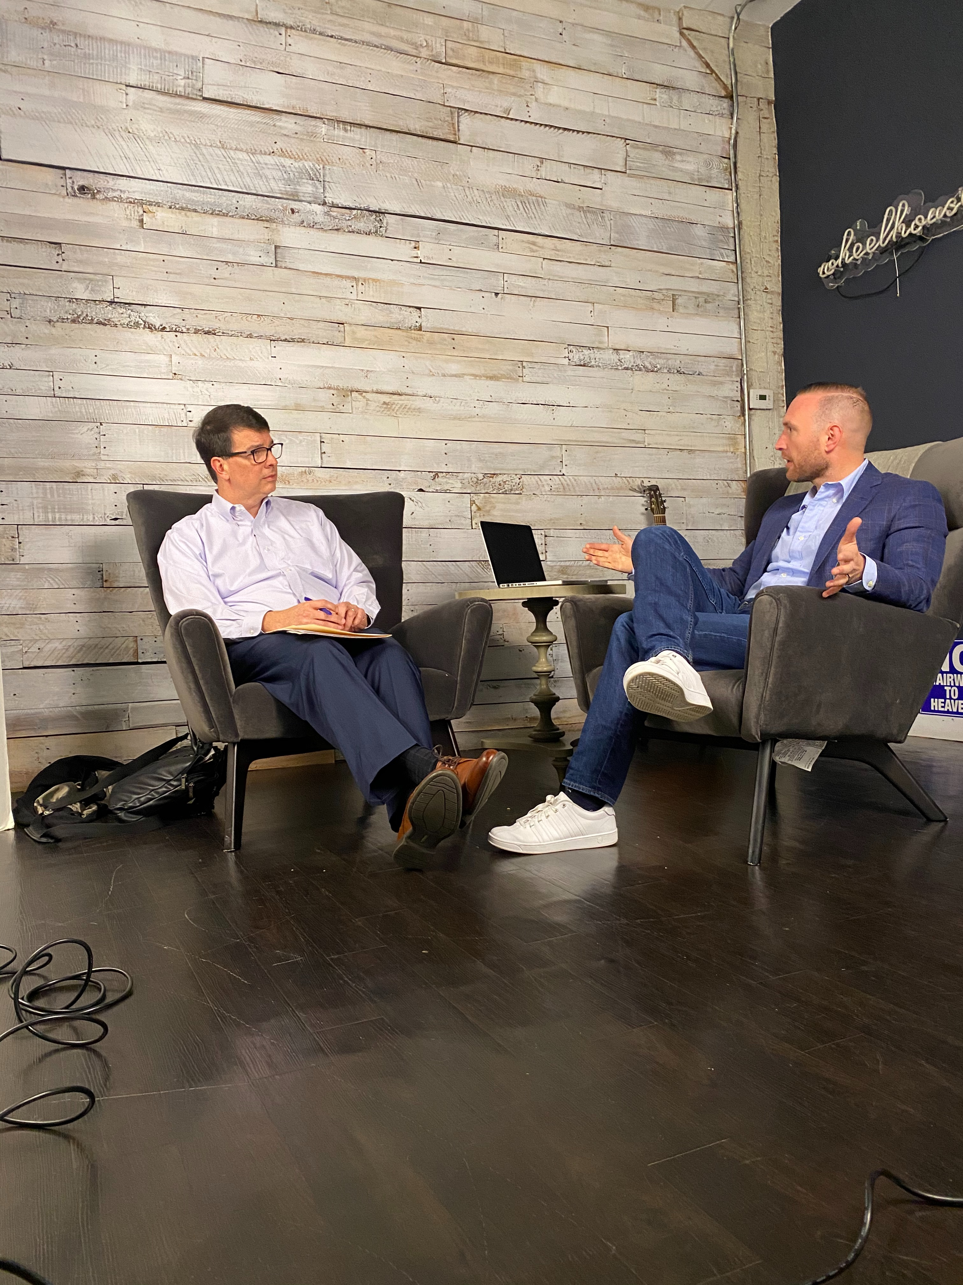
Media Blitz
Podcasts
Social Media
TV
Content, Content, Content

Slide 5
Community Engagement 2020
NEW – Shakespeare Program, Pre-K
Symphony, CTC

