Slide 1
February, 2020 Board Meeting

Slide 2
January Pledge Activity
8 new pledges totaling $26,125 on a $25,000 goal
We remain $205,975 ahead of goal because of November and December successes
Total Founders’ Society members – 120 (5 new in January)

Slide 3
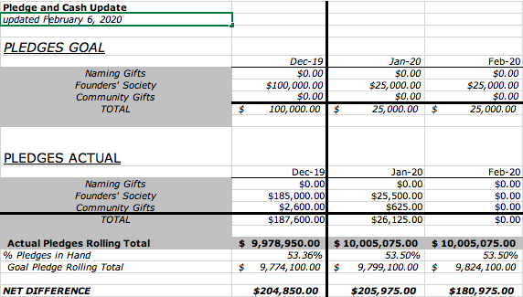
3 Month Snapshot – Pledges

Slide 4
January Cash Activity
18 payments totaling $77,791

Slide 5
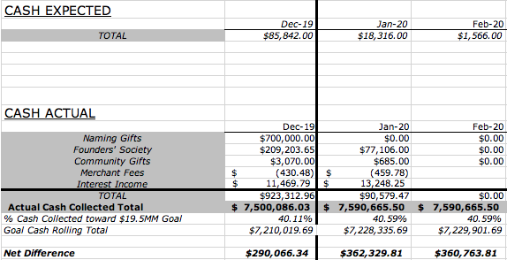
3 Month Snapshot - Cash

Slide 6
2020 - The Campaign Ahead
Left to Raise: $9,487,425
Naming Gifts: $8,000,000
Community Gifts: $1,500,000
Includes Brick Campaign $500,000
Local Businesses and Families/Individual $1,000,000

Slide 7
2020 Campaign Update
THIS IS THE YEAR
Campaign Cabinet Report
Major Gifts and Business
Individuals/Families and Campaign Support
Events Update
Gala
Upcoming Private & Community Events

Slide 8
2020 Campaign Update
Campaign Cabinet Report
Major Gifts and Business (Woody, Joshua)
Individuals/Families and Campaign Support (Cynthia, Bill)

Slide 9
2020 Strategies
Campaign Support Committee Recommended Policies for Public Phase
As of May 1, 2020:
Pledge period becomes 24 months.
Gift must be $2,500 or more to be pledged out over time, and pledging becomes a benefit of joining the Founders’ Society.
Three payment options are available:
Quarterly
Semi-Annually
Annually
Pledge cards no longer required for gifts outright.
Staff will continue to verify acknowledgement on gifts of $2,500 and above.
Gifts of less than $2,500 will be acknowledged by email.
Paver campaign is entirely transactional.

Slide 10
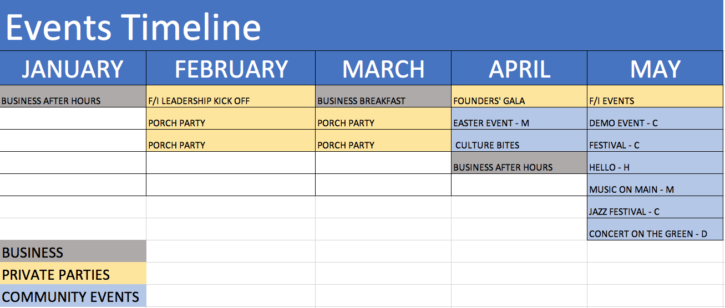
2020 Events

Slide 11
2020 Founders’ Gala

Slide 12
2020 Gala
Goals of the Event:
Raise Money
Honor our Founders’ Society Members
Cultivate Naming, Business, and Founders’ Society level donors

Slide 13
2020 Founders’ Gala
Founders’ Gala
Committee:
Sharon and Woody Washam
Pat Bechdol
Cynthia Bush
Joy Evans
Meredith Fite
Della Stafford
Vickie VanWingerden

Slide 14
2020 Founders’ Gala

Slide 15
2020 Founders’ Gala
The Evening:
5:30 Pre-reception to honor sponsors, Cain level donors, and top prospects
6:30 Guests arrive. Cocktails and passed hors d’oeuvres
Paver sales begin
Music by Bill Ward Jazz Trio
Seated dinner, doors open at 7:30
Reveal new renderings, video fly-through
Live auction
Paddle-Raise pledging
Dessert reception, more jazz
Valet and rides home

Slide 16
2020 Founders’ Ball
WHAT WE’VE ACCOMPLISHED:
A goal-driven plan
Outstanding Committee
Invitations are on press and on time
Subcommittees working on details
Prospect lists delivered to board members
First sponsorship successful
WHAT LIES AHEAD:
Executing the collateral
Finalizing menu, décor, vendors
Finalizing presentation
Inviting guests and cultivating donors

Slide 17
2020 Founders’ Ball
WHAT WE NEED:
Board members to return their invite lists.
First deadline 2/4
2/17 absolute deadline

Slide 18
This is What We’re Asking the Board to do:
Complete your invitation list by this Friday.
Hand deliver invitation when possible beginning February 17
Personalize mailed invitations by February 21
Make it clear that the goal of the evening is fundraising
Cultivate your prospects:
Have coffee
Host a porch party
Make a personal phone call
Send email with electronic invitation now
Follow up for RSVP
Arrive at the event by 6:15 to greet guests
Circulate, answer questions, be an ambassador

