Slide 1
March, 2020 Board Meeting

Slide 2
February Pledge Activity
11 new pledges totaling $91,025 on a $25,000 goal
Includes 2 Sponsorships – Keele Family and Randy Marion
8 new Founders’ Society Members in February

Slide 3
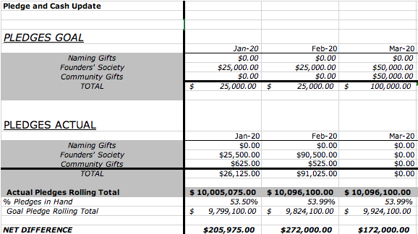
3 Month Snapshot – Pledges

Slide 4
January Cash Activity
22 payments totaling $83,590.48
on a $1,566.00 goal

Slide 5
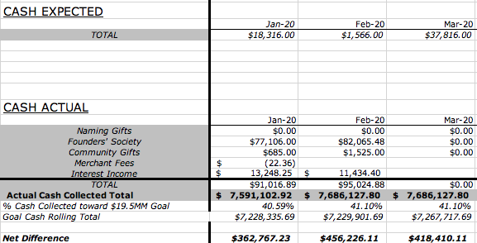
3 Month Snapshot - Cash

Slide 6
2020 - The Campaign Ahead
Left to Raise: $9,398,900

Slide 7
Paver Campaign

Slide 8
3 Sizes of Pavers
6” x 6”
6” x 12”
12” x 12”

Slide 9
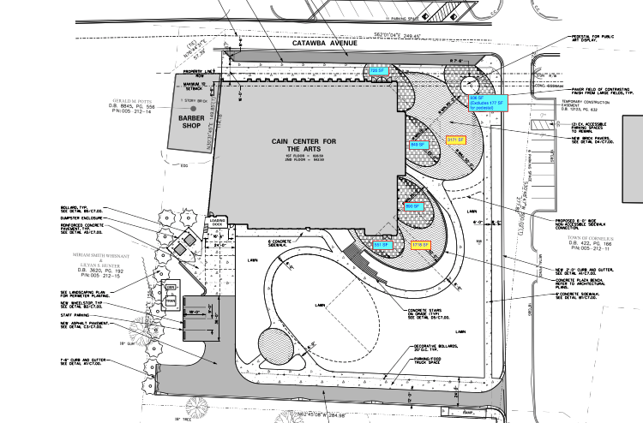

Slide 10
Potentially 8,000 Pavers
The number of potential pavers provides a number of opportunities and challenges:
  How many can we reasonably sell?
  What is our timeframe for selling?
  What is the appropriate price point for the three sizes of pavers?

Slide 11
How Much Revenue Could Pavers Produce?
 | 6X6 | 6X12 | 12x12 | Total
Units | 500 | 350 | 250 | 1,100
Price/Unit | 250 | 500 | 1000 | $500.00
Revenue | $125,000 | $175,000 | $250,000 | $550,000
Price/Unit | 500 | 1000 | 2000 | 3,500
Revenue | $250,000 | $350,000 | $500,000 | $1,100,000
Price/Unit | 125 | 250 | 500 | 875
Revenue | $62,500 | $87,500 | $125,000 | $275,000

Slide 12
Campaign Cabinet Recommendations
We need to reach our goal of $500,000 by 12/31/20 to meet our defined campaign goal.
Phase I timeframe 4/3/2020 to 12/31/20
Price Tiers $250, $500, $1,000
Recruit Task Force:
  Organize details of Phase One launch May 1
  Execute Gala paver sales
  Create data driven Phase Two

Slide 13
Aquesta Naming Agreement
Request to add to Section 8:
8(a), Donor may assigning the rights under this agreement to a successor in interest, including a corporate acquirer of its corporate charter through merger or otherwise and / or an acquirer of substantially all of the Donor’s assets and liabilities through a purchase/ merger or other type of acquisition or reorganization transaction.
8(b), A successor in interest as described in 8(a) above shall be entitled to have the benefits of this contract (Naming rights under Section 4) changed to such successor’s tradename. The cost of modification of any related signage, etc., shall be solely the responsibility of such successor. The change of naming in accordance with this provision shall not be unreasonably withheld or denied pursuant to section 5 of this agreement.

Slide 14
Non-Discrimination Policy
Cain Center for the Arts does not discriminate against any person based on age, sex, race, color, creed, religion, sexual orientation, political affiliation or national origin in the operation, conduct, or administration of community recreation programs or its facilities. Third parties who receive a contract, permit, or similar use authorization from Cain Center for the Arts to operate, conduct, administer or offer a class/program, activity or service are also prohibited from discriminating based on age, sex, race, color, creed, religion, sexual orientation, political affiliation or national origin.

Slide 15
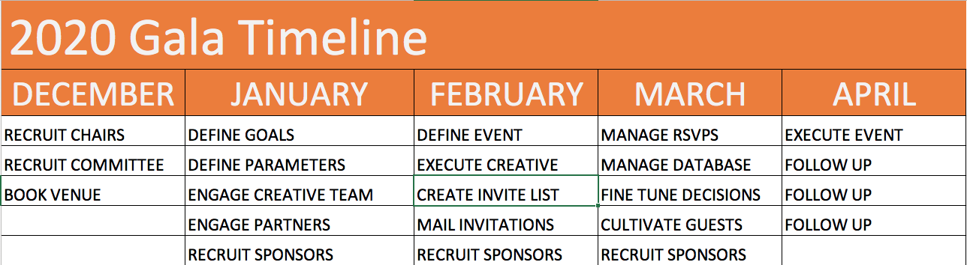
2020 Founders’ Gala

Slide 16
2020 Founders’ Gala
Confirmed Sponsors:
Aquesta Bank
Randy Marion
Keele Family Foundation
Atrium Health

Slide 17
2020 Founders’ Gala
Invitations went out on February 21st
120 guests have accepted the invitation
Goal is 200 – 240 guests
Follow up: Call your prospects and ask if they received their invitation. Personally invite them to join us.

Slide 18
2020 Founders’ Gala
The Evening:
5:30 Pre-reception to honor sponsors, Cain level donors, and top prospects
6:30 Guests arrive. Cocktails and passed hors d’oeuvres
Music by Bill Ward Jazz Trio
Seated dinner, doors open at 7:30
Reveal new renderings, video fly-through
Live auction
Paddle-Raise / Paver Sales
Dessert reception, more jazz
Valet and rides home

Slide 19
Gala Success
Cultivate your list:
  Make a phone call
  Take someone to coffee
  Make a personal ask
Arrive at 6:15 to greet guests
Be the first to buy a paver
Be ready to follow up with thanks and asks

Slide 20
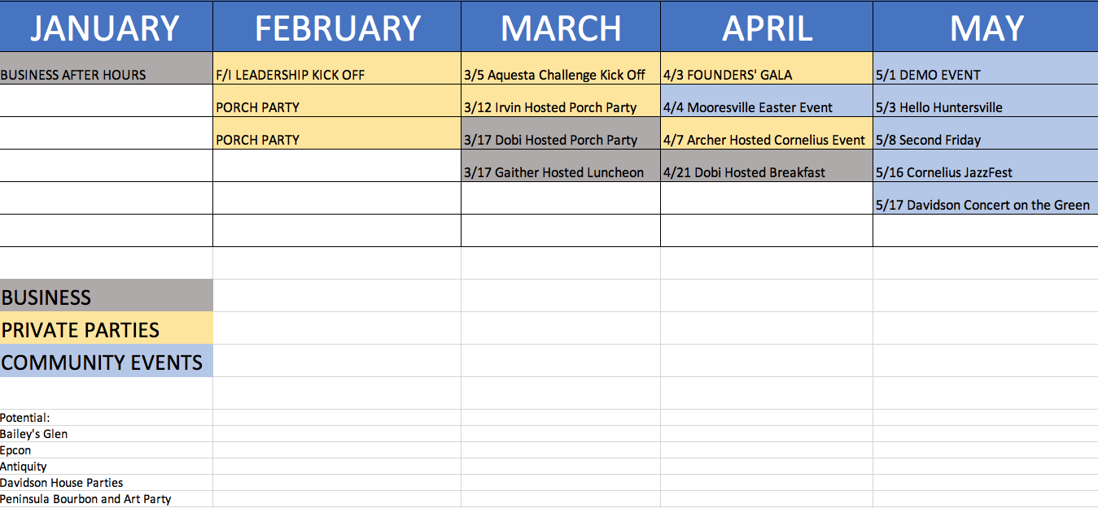
2020 Events

