Slide 1
March, 2020 Executive Committee Meeting

Slide 2
February Pledge Activity
11 new pledges totaling $91,025 on a $25,000 goal
2 Sponsorships – Keele Family and Randy Marion
8 new Founders’ Society Members in February

Slide 3
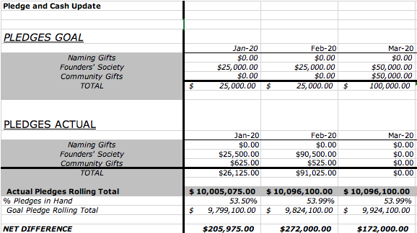
3 Month Snapshot – Pledges

Slide 4
January Cash Activity
22 payments totaling $83,590.48
on a $1,566.00 goal

Slide 5
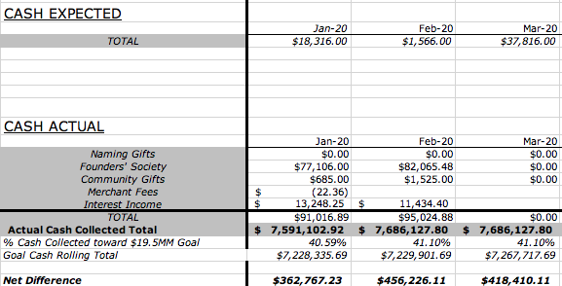
3 Month Snapshot - Cash

Slide 6
2020 - The Campaign Ahead
Left to Raise: $9,398,900

Slide 7
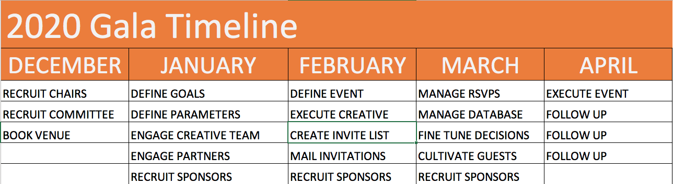
2020 Founders’ Gala

Slide 8
Paver Campaign

Slide 9
Potentially 8,000 Pavers
The number of potential pavers provides a number of opportunities and challenges:
  How many can we reasonably sell?
  What is our timeframe for selling?
  What is the appropriate price point for the three sizes of pavers?

Slide 10
How Much Revenue Could Pavers Produce?
 | 6X6 | 6X12 | 12x12 | Total
Units | 500 | 350 | 250 | 1,100
Price/Unit | 250 | 500 | 1000 | $500.00
Revenue | $125,000 | $175,000 | $250,000 | $550,000
Price/Unit | 500 | 1000 | 2000 | 3,500
Revenue | $250,000 | $350,000 | $500,000 | $1,100,000
Price/Unit | 125 | 250 | 500 | 875
Revenue | $62,500 | $87,500 | $125,000 | $275,000

Slide 11
Campaign Cabinet Recommendations
We need to reach our goal of $500,000 by 12/31/20 to meet our defined campaign goal.
Phase I timeframe 4/3/2020 to 12/31/20
Price Tiers $250, $500, $1,000
Recruit Task Force:
  Organize details of Phase One launch May 1
  Execute Gala paver sales
  Define Gala Support Needs

Slide 12
Additional Opportunity
Sell interior pavers at a premium beginning 4/3 to Founders’ Society Members and gala guests
Price point of $2,000
Open to wider audience 4/4 with email to Founders’ Society members
250 initial interior pavers = $500,000

Slide 13
Approved Campaign Budget
Campaign Support | $ 37,000
Marketing | $153,500
Legal and Processing Fees | $ 45,000
Events | $115,000
Cultivation Meetings | $ 10,000
Donor Recognition | $ 20,000
Contingency | $ 55,895
Total: |  | $436,395

Slide 14
Campaign Marketing Budget
Video | $80,000
Paver Campaign | $ 5,000
Aquesta Challenge | $ 5,000
Print Media | $ 7,500
Radio | $ 3,000
Digital Media | $25,000
Content Specialist | $10,000
Campaign Collateral | $10,000
Branded Giveaways | $ 5,000
Presentation Materials | $ 500
Contingency | $ 2,500
Total: |  | $153,500

