Slide 1
April, 2020
Executive Director Report

Slide 2
Current Status
Campaign Position – STABLE
  Positive momentum built
  Construction Docs Begun
  Renderings and Fly Through nearing finalization
  Over $5.8MM in Capital Escrow Account
Operational Position – STABLE
  Increased social media position
  Increased content library
  Stable financial picture – expenses covered through end of June
  Community engagement programming continuing

Slide 3
Unknowns
Campaign
  Impact to campaign timeline?
  Impact to construction timeline?

Slide 4
PROGRAM! PROGRAM! PROGRAM!
Making Waves Digital Show
Community Engagement Pivot
  New partnerships with local Non-Profit Health & Human Services Organization to create Arts & Culture Wish Lists
    Ada Jenkins Center
    Children’s Hope Alliance

Slide 5
April, 2020 Campaign Report

Slide 6
March Pledge Activity
15 new pledges totaling $73,665 on a $100,000 goal
Total pledges equal $10,169,765
Total fundraising, including land and bond, equals $15,669,765
This total does not include verbal pledge of $250,000 from Aquesta Bank

Slide 7
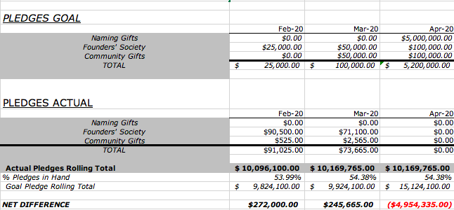

Slide 8
March Cash Activity
23 payments totaling $67,546 on a goal of $37,816

Slide 9
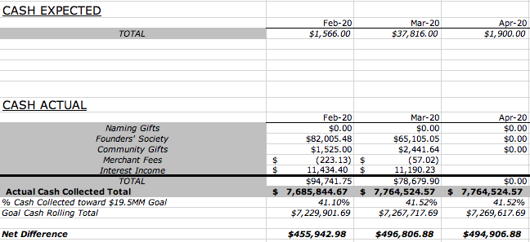

Slide 10
RECOMMENDATION
Delay Public Phase fundraising for some period of time
  Continue focus on major gifts
  Continue to seek grants
  Stay in front of donors with positive news and programs

Slide 11
Original Plan
December 31, 2020 Campaign fully pledged
February 1, 2021 Bidding begins
April 1, 2021 Construction begins
June, 2022 Construction complete
September, 2022 First season begins

Slide 12
New Scenario
3- Month Public Phase Delay
July 1, 2020 Resume
No capital fundraising takes place April 1 – June 30
Use time to support partners, communicate, execute projects, plan
July 1 house parties resume
In person gala takes place 9/12/20
Brick campaign kicks off at gala
Public phase kicks off 10/1/20
Community events resume

Slide 13
New Scenario Timeline
July 1, 2020 Resume
April 31, 2021 Campaign fully pledged
May 1, 2021 Bidding begins
July, 2021 Construction begins
October, 2022 Construction complete
December, 2022 Soft open
Fall, 2023 First full season begins

Slide 14
CCA – Covid-19 Scenarios
2020
2021
2022
2023
MAR
MAY
AUG
NOV
MAR
MAY
OCT
DEC
AUG
DEC
APR
JUN
OCT
FEB
APR
JUN
SEP
DEC
JUN
JAN
JAN
FEB
MAY
JUL
JUL
SEP
DEC
AUG
NOV
MAY
JAN
APR
SEP
JUL
JUN
OCT
MAR
OCT
FEB
JUL
NOV
AUG
NOV
APR
SEP
FUNDRAISING
Original
PUBLIC CAMPAIGN
ANNUAL FUND / ENDOWENT
Scenario 1
Quiet
Ramp
PUBLIC CAMPAIGN
ANNUAL FUND / ENDOWMENT
CONSTRUCTION & OPENING
Original
CD’S
BID
Construction & Move In
SOFT
SEASON 1
SEASON 2
Scenario 1
CD’S
BID
Construction & Move In
SOFT
1/2 SEASON
SEASON 1
OPERATIONS
CAC
CAC RAMP
CAC SOFT
CAC YEAR 1
Staff
PM
TD
BO & OTHERS
Scenario 1
PM
TD
BO & OTHERS

