Slide 1
May, 2020
Board Development Report

Slide 2
April Pledge Activity
4 new pledges totaling $10,100 on a $10,000 goal
1 matching gift from Bank of America
Total pledges equal $10,180,365
Total fundraising, including land and bond, equals $15,680,365
This total does not include verbal pledge of $250,000 from Aquesta Bank

Slide 3
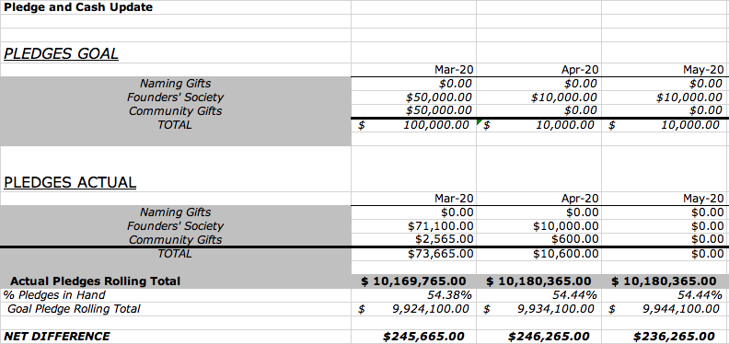

Slide 4
April Cash Activity
18 payments totaling $11,551 on a goal of $36,578

Slide 5
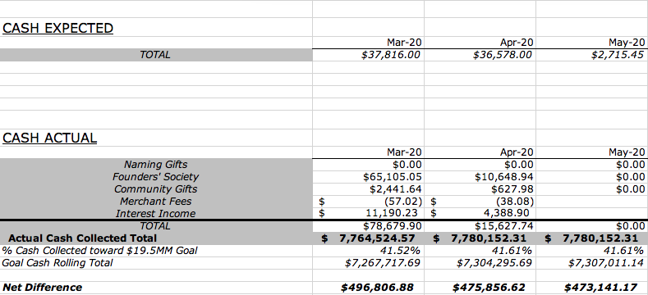

Slide 6
VIRTUAL RENDERING REVEAL
Wednesday, May 6 Press Release
Monday, May 18 Live Virtual Event for Founders’ Society – Zoom Webinar
Public Reveal – YouTube :
Tuesday, May 19 Exterior and Lobby
Tuesday, May 26 Education Spaces
Tuesday, June 2 Gallery and Theater

Slide 7
WE MET OUR APRIL PLEDGE GOAL BECAUSE OF DONORS
WHO HAD PLANNED TO GIVE AT THE GALA

Slide 8
LET’S BLOW OUR MAY GOAL OUT OF THE WATER!
Review your list of Gala invitees.
Touch base with them to let them know that we’re revealing the renderings and invite them to join in.
Follow up after the reveal.
Ask them to consider joining the Founders’ Society now, when it matters more than ever.

Slide 9
TOOLS FOR RECONNECTING TO OUR GALA GUESTS:
Your list of invitees and their responses
Link to the zoom webinar
Founders’ Society newsletter

Slide 10
Pledge Period

