Slide 1
June, 2020
Board Presentation

Slide 2
May Pledge Activity
9 new pledges totaling $27,633
Total fundraising, including land and bond, equals $15,707,998
This total does not include verbal pledge of $250,000 from Aquesta Bank

Slide 3
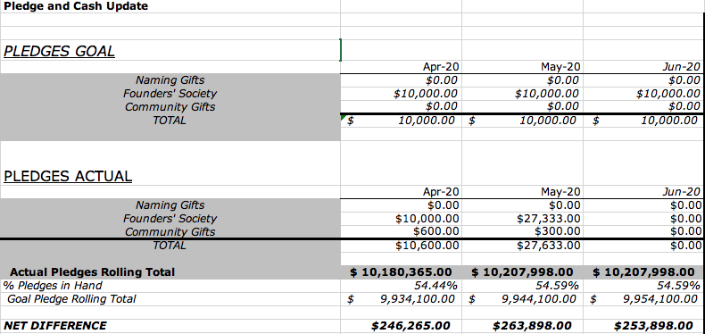

Slide 4
June Board Challenge

Slide 5
May Cash Activity
23 payments totaling $39,469 on a goal of $2,715

Slide 6
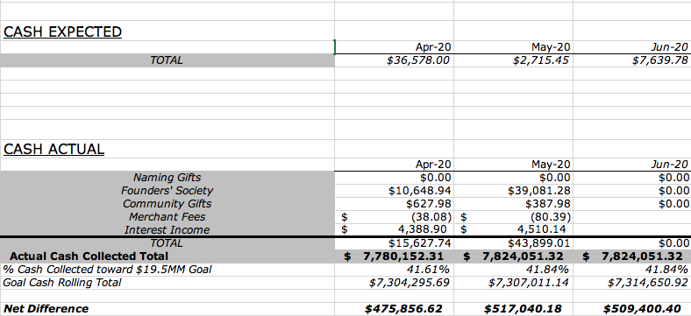

Slide 7
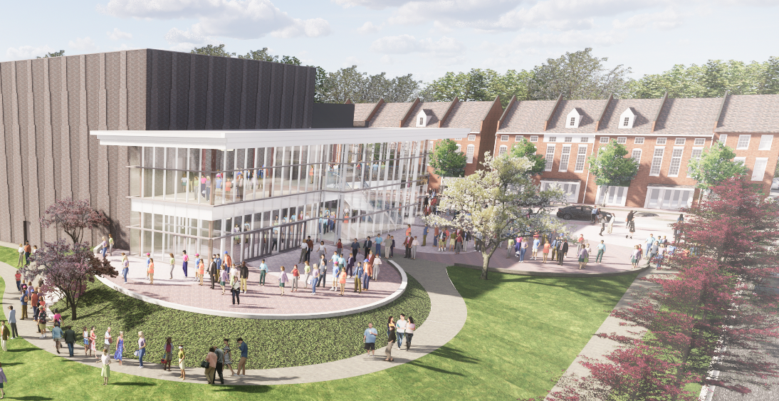
Brick Campaign

Slide 8
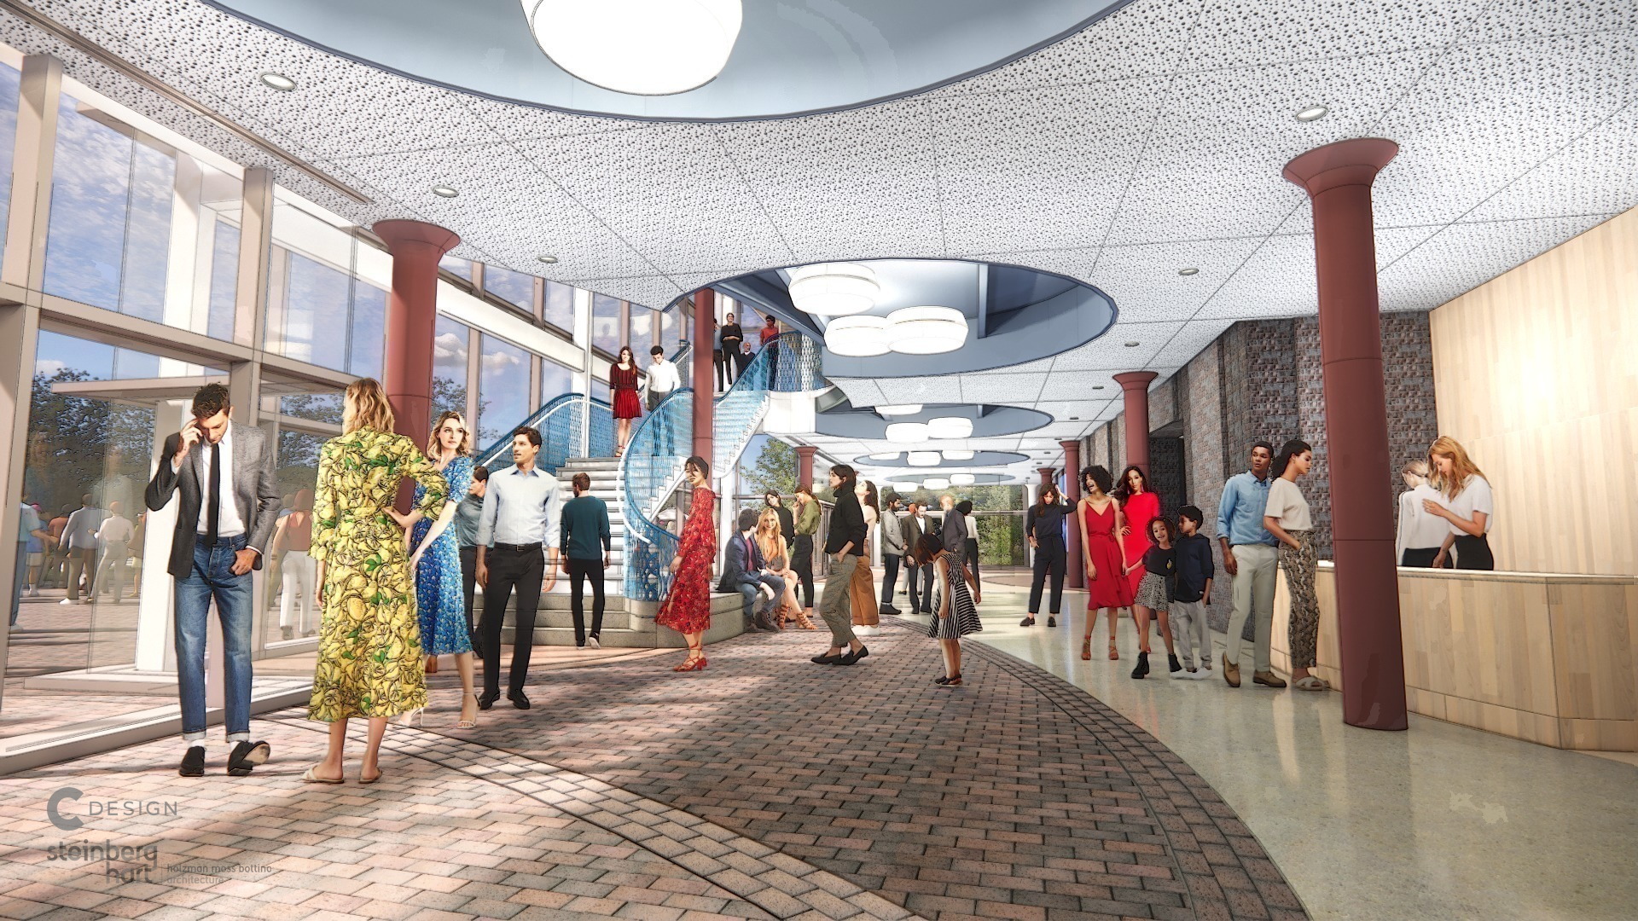
Brick Campaign

Slide 9
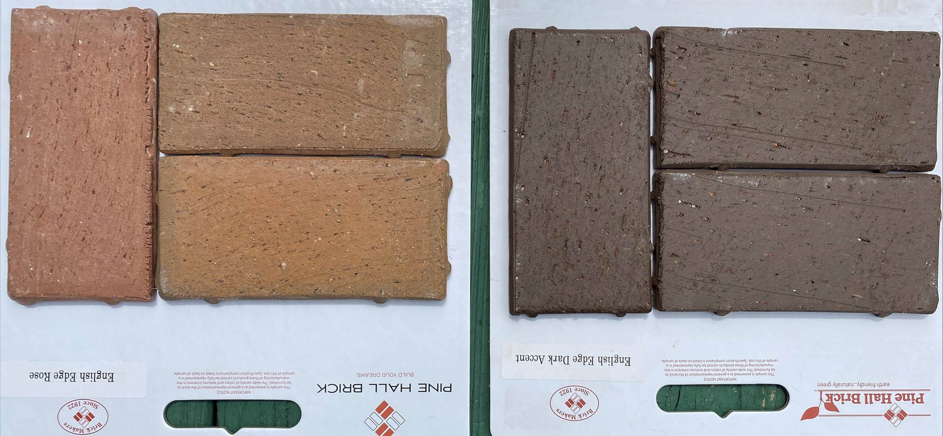
Brick Campaign Materials

Slide 10
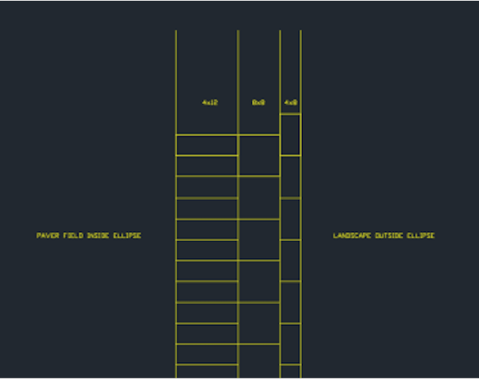
Brick Campaign Design Layout and Orientation of Copy

Slide 11
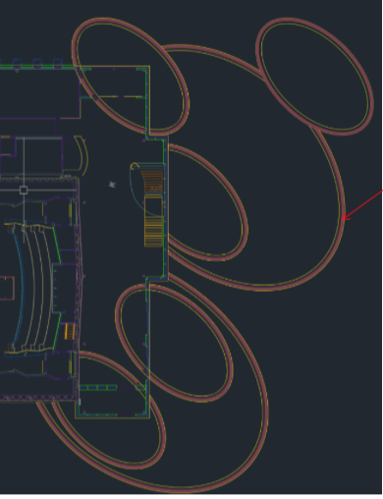
Brick Campaign Placement of Engraved Bricks

Slide 12
Brick Campaign Inventory and Pricing
 | SIZE | # AVAILABLE | PRICE
INTERIOR
 | 4 x 8 | 128 | $250
 | 4 x 12 | 241 | $500
 | 8 x 8 | 126 | $1,000
EXTERIOR
 | 4 x 8 | 1,094 | $250
 | 4 x 12 | 2,097 | $500
 | 8 x 8 | 1,089 | $1,000
TOTAL: |  | 4,775

Slide 13
Brick Campaign Potential Net Revenue on Goal of $500,000:
Brick Size | Selling Price | Cost of Engraving | Number Available
4 x 8 | $250.00 | $18.00 | 1222
4 x 12 | $500.00 | $35.00 | 2338
8 x 8 | $1,000.00 | $45.00 | 1215
Net Revenue
100% of Bricks Sold | $2,530,388.00
50% Sold | $1,265,194.00
25% Sold | $632,597.00

Slide 14
Brick Campaign Print Guidelines:
SIZE | NUMBER OF LINES | CHARACTERS PER LINE
4 x 8 | 3 Lines | 20 Characters per Line
4 x 12 | 3 Lines | 23 Characters per Line
8 x 8 | 6 Lines | 20 Characters per Line
CONTENT GUIDELINES:
IN HONOR OF (NAME)
IN MEMORY OF (NAME)
FAMILY NAME (S)
COMPANY NAME

Slide 15
Brick Campaign Timeline
 | June | July | August | September | October
 | Founders’ Society newsletter announces campaign | Interior and Exterior bricks available to Founders | Webpage live for Demolition | 9/12 deadline for Founders exclusive access to interior bricks | Public Campaign Begins
 | E-mail to Founders opening early access | Webpage live for Founders | Exterior bricks available to public | Potential Direct Mail to LKN community
 |  | Virtual campaign to Founders' Society members begins | Interior bricks available to donors who become new Founders
 |  | Founders' newsletter contains link to webpage | Social media continues
 |  | Social media begins to promote demolition sales | Printed materials available
 |  | Printed materials go to press
FUNDRAISING GOAL: |  | $50,000 | $50,000 | $75,000 | $50,000
ACTIVITY: |  | Early Founders’ Access | Demolition Event | Founders’ Gala | Public Campaign Begins

Slide 16
GALA UPDATE

Slide 17
Gala Committee Recommendations:
An in-person gala for 200 or more guests in one location isn’t feasible at this time.
We have options for hosting a virtual event or smaller events in multiple locations, or a combination of the two.
They would like to pursue a more traditional gala in the first quarter of 2021.

Slide 18
Gala Committee Recommendations:
Next Steps:
Survey
Understand Governor’s orders in Phase III
Budget
Prepare a plan for July Board approval

Slide 19
Policy Reminder:
July 1 begins 24-month pledge period

