Slide 1
June, 2020
Report to Executive Committee

Slide 2
May Pledge Activity
9 new pledges totaling $27,633
Total fundraising, including land and bond, equals $15,707,998
This total does not include verbal pledge of $250,000 from Aquesta Bank

Slide 3
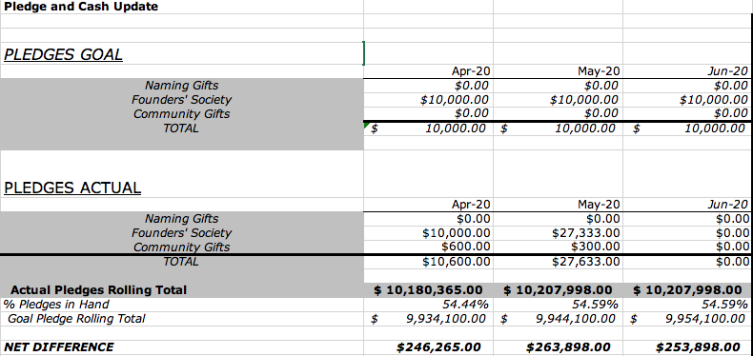

Slide 4
June Board Challenge

Slide 5
April Cash Activity
23 payments totaling $39,469 on a goal of $2,715

Slide 6
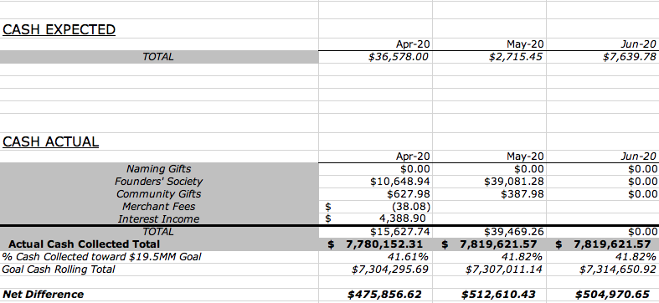

Slide 7
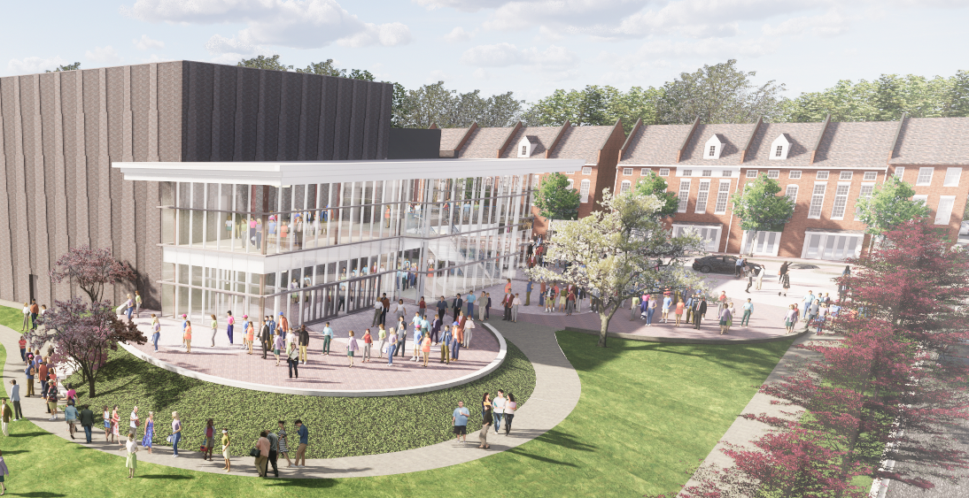
Brick Campaign

Slide 8
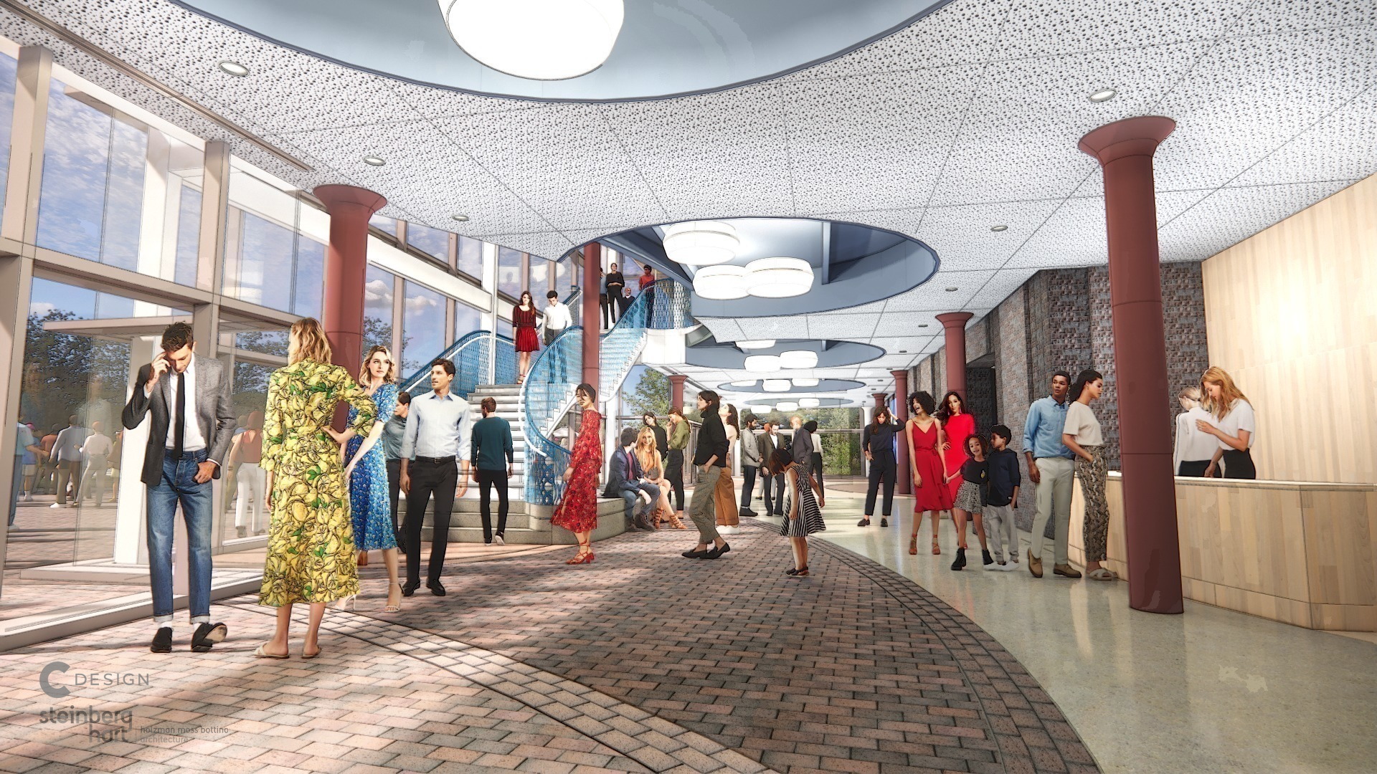
Brick Campaign

Slide 9
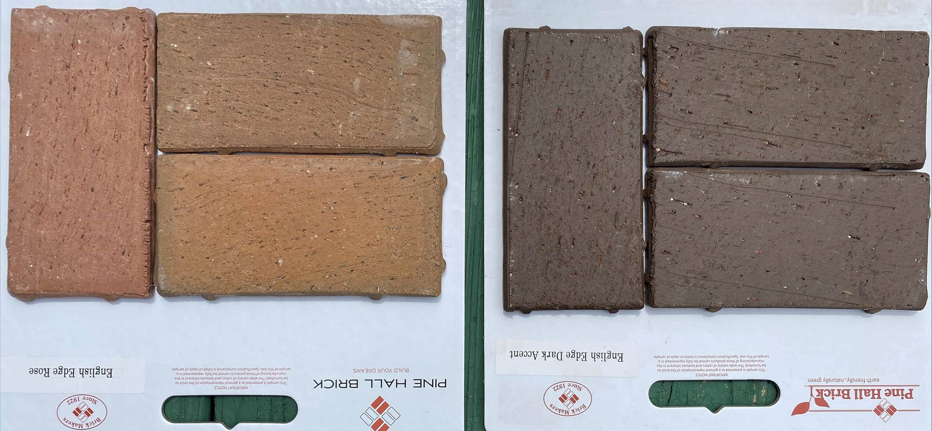
Brick Campaign Materials

Slide 10
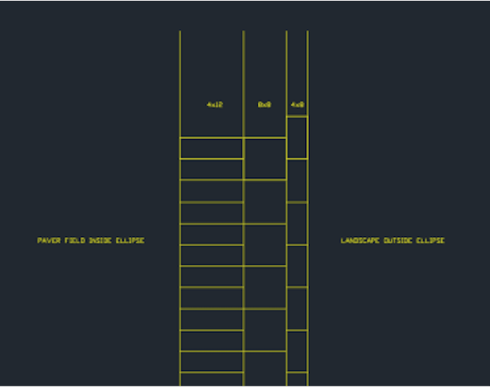
Brick Campaign Design Layout and Orientation of Copy

Slide 11
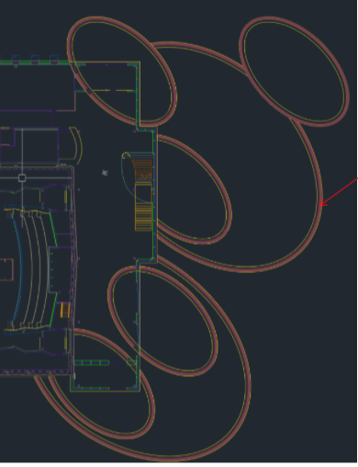
Brick Campaign Placement of Engraved Bricks

Slide 12
Brick Campaign Inventory and Pricing
 | SIZE | # AVAILABLE | PRICE
INTERIOR
 | 4 x 8 | 128 | $250
 | 4 x 12 | 241 | $500
 | 8 x 8 | 126 | $1,000
EXTERIOR
 | 4 x 4 | 1,094 | $250
 | 4 x 12 | 2,097 | $500
 | 8 x 8 | 1,089 | $1,000
TOTAL: |  | 4,775

Slide 13
Brick Campaign Potential Net Revenue:
Brick Size | Selling Price | Cost of Engraving | Number Available
4 x 8 | $250.00 | $18.00 | 1222
4 x 12 | $500.00 | $35.00 | 2338
8 x 8 | $1,000.00 | $45.00 | 1215
Net Revenue
100% of Bricks Sold | $2,530,388.00
50% Sold | $1,265,194.00
25% Sold | $632,597.00

Slide 14
Brick Campaign Print Guidelines:
IN HONOR
IN MEMORY
FAMILY NAME(S)
COMPANY NAME(S)

Slide 15
Brick Campaign Print Guidelines:
SIZE | NUMBER OF LINES | CHARACTERS PER LINE
4 x 8 | 3 Lines | 20 Characters per Line
4 x 12 | 3 Lines | 23 Characters per Line
8 x 8 | 6 Lines | 20 Characters per Line

Slide 16
Brick Campaign Timeline
 | April | May | June
 | Establish campaign timeline | Establish price points and expenses | Present Task Force Recommendations to Executive Committee
 | Meet with Task Force Chair | Establish proposed campaign parameters | Present Task Force Recommendations to Board
 | Meet with Task Force | Take proposal to Campaign Cabinet | Complete website and marketing design for public
 | Preliminary Design | Move campaign collateral forward | Complete detailed campaign marketing timeline
 | Preliminary Webpage | Task Force establishes recommendations | Complete commerce details for brick sales
 |  |  | Complete design of marketing materials
 |  |  | Final budget established with pivot away from high touch
 |  |  | Complete details for point of sale
 |  |  | Founders' newsletter contains tease
Goal: | $0.00 | $0.00 | $0.00
Driver:

Slide 17
Brick Campaign Timeline
 | July | August | September
 | Interior and Exterior bricks available to Founders | Webpage live for Demolition | 9/12 deadline for Founders exclusive access to interior bricks
 | Webpage live for Founders | Exterior bricks available to public | Potential Direct Mail to LKN community
 | Virtual campaign to Founders' Society members begins | Interior bricks available to donors who become new Founders
 | Founders' newsletter contains link to webpage | Social media continues
 | Social media begins to promote demolition sales | Printed materials available
 | Printed materials go to press for delivery by July 27
Goal: | $50,000.00 | $50,000.00 | $75,000.00
Driver: | Bricks available exclusively to Founders for a limited time | Bricks available to public at Demolition event | Gala and more access to bricks for the public

Slide 18
Brick Campaign Timeline
 | October | November | December | January | February | March | April | TOTAL
 | Public Campaign begins
Goal: | $50,000.00 | $50,000.00 | $50,000.00 | $50,000.00 | $50,000.00 | $50,000.00 | $50,000.00 | $525,000.00
Driver: | Public Campaign | Public Campaign | Public Campaign | Public Campaign | Public Campaign | Public Campaign | Public Campaign

Slide 19
GALA UPDATE

Slide 20
Gala Committee Recommendations
Committee recommends that an in person Gala in September comes off the table.
Leaning toward smaller in person events in private homes, supported by virtual events.
Pursue a more traditional gala in the first quarter of 2021.
Next Steps:
Survey
Understand Governor’s orders in Phase 3
Budget
Prepare a plan for July Board approval

Slide 21
POLICY REMINDER
JULY 1 begins 24-month pledge period

