Slide 1
July 13, 2020
Board Presentation

Slide 2
June Pledge Activity
11 new pledges totaling $1,293,420
Total fundraising, including land and bond, equals $17,001,418

Slide 3
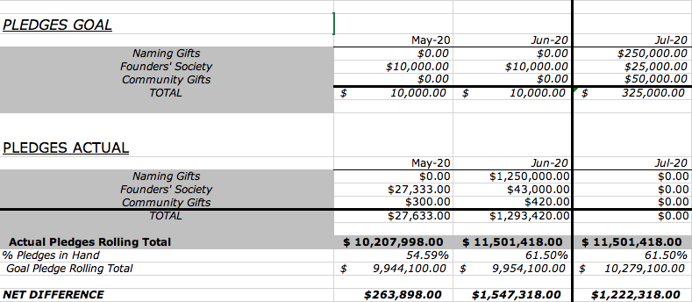

Slide 4
June Cash Activity
24 payments totaling $98,308 on a goal of $7,600

Slide 5
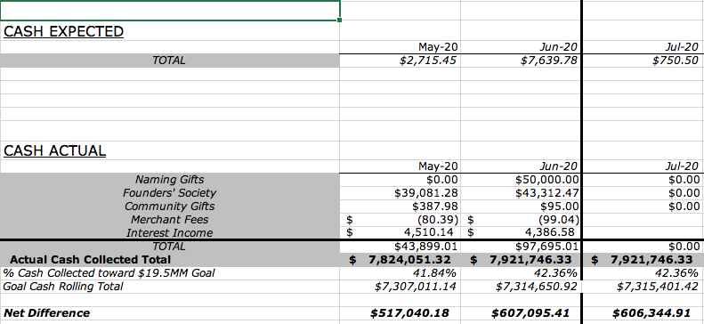

Slide 6
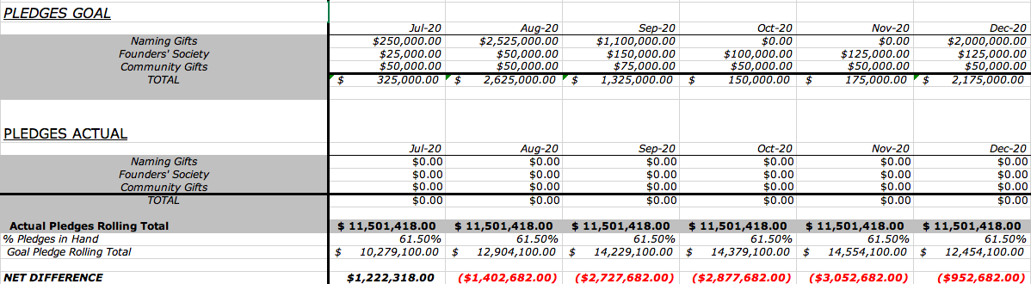
6-Month Snapshot:

Slide 7
Aquesta Challenge
14 Aquesta Challenge Pledges
Pledges totaling $73,800
Aquesta is matching $41,300 (up to $10,000)
Almost 20% of $250,000 goal

Slide 8
Campaign Activity: Our Position Remains Stable
We have continued our focus of Major Donors
We continue to seek grants, including Federal Funding
We have stayed in front of our donors with positive message

Slide 9
PLAN FOR MOVING FORWARD
What are we allowed to do?
What are our constituents’ preferences?
Governor’s Phase 2 Orders, through July 17, 2020:
Gather 10 attendees indoors
Gather 25 attendees outdoors
Masks are required within 6 feet

Slide 10
PLAN FOR MOVING FORWARD
What are we allowed to do?
What are our constituents’ preferences?
Our Survey Results:
  Some people (about half) would be comfortable attending an event at a private home, public venue, or virtually
  Some would feel comfortable attending an event in September, but far more in the fourth quarter
  By far, people would prefer events with an outdoor option
  Some people would be comfortable at some kinds of events, but not if they are indoor only
  Most people prefer events of 50 people or fewer
  Most would like to see extensive safety measures

Slide 11
WHAT DOES THIS TELL US?
Some people are ready to gather in small groups and outdoors
Some people are not
The kind of outdoor community events we have been relying on to meet people and sell bricks aren’t likely to take place in 2020
We have an opportunity to be a leader in safely bringing people back together

Slide 12
SHIFT IN STRATEGY
Rely on events that are small and individualized
Gala Chairs and Campaign Chair recommend holding Gala funds until 2021, not holding Gala in 2020.
Increase marketing to increase awareness, adding direct mail and print advertising
Lean into Brick Campaign

Slide 13
EVENTS
VIRTUAL EVENTS
  Founders’ Society Brick Campaign Kick-Off
  Virtual After-Hours Events

Slide 14
EVENTS
QUARANTEAM EVENTS
  Small Porch Parties for 3-4 families
  Curated Chefs Dinners for several couples
  Living Room Sessions with Live Performance, Lectures, or Guided Tours

Slide 15
EVENTS
BRING A DONOR TO THE TABLE
Reserved Cain Center for the Arts tables at area restaurants with outdoor seating, available to board members and others for inviting prospects to share a meal and contribute to the campaign

Slide 16
MARKETING
ADJUSTMENTS TO OUR PLAN:
1. Direct mail to 90,000 households
2. Print advertising in LKN publications plus Charlotte Business Journal
3. Slight shift away from printed hand-outs
4. Shift toward banners and posters

Slide 17
BRICK CAMPAIGN
Brick Campaign Task Force:
Jean Bock, Chair
Steve True, Davidson/Marketing
Meredith Fite, The Peninsula Community
Lisa Estes, Logistics and Record Keeping
Bill Morgan, Campaign Cabinet Support Chair

Slide 18
Brick Campaign Timeline
 | July | August | September
 | Interior and Exterior bricks available to Founders | Webpage Live to Founders | Public Campaign
 | Webpage live for Founders | Exterior bricks available to public | Direct Mail to LKN community
 | Virtual campaign to Founders' Society members begins | Interior bricks available to donors who become new Founders | Social Media Push
 | Founders’ Society Virtual Launch Party | Social media continues | Print Ad Campaign
Supported by:
Small Events
Aquesta Challenge and Business Division
Family and Individual Division

Slide 19
Founders’ Society Brick Launch
Email invitation goes out to our 140 Founders’ Society households on Tuesday, July 14th
Join us for a virtual cocktail party and private Brick Campaign launch
Working in partnership with Peninsula Club to create wine baskets
Founders can pick their baskets up at the Club on the 21st
Zoom event will take place at 5:30 on the 21st
Jean Bock and Meredith Fite are lead volunteers
Working on surprise guest

Slide 20
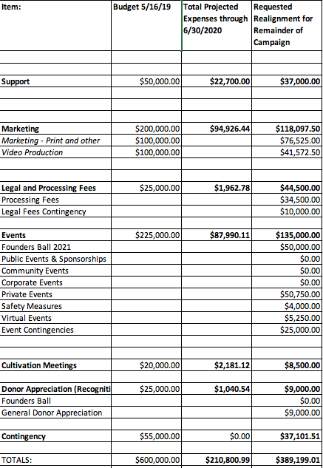
BUDGET

