Slide 1
August, 2020 Board Presentation

Slide 2
July Pledge Activity
2 new pledges totaling $32,500 on goal of $275,000
Notes:
*$275,000 goal included Aquesta pledge of $250,000 which came in during the month of June.

Slide 3
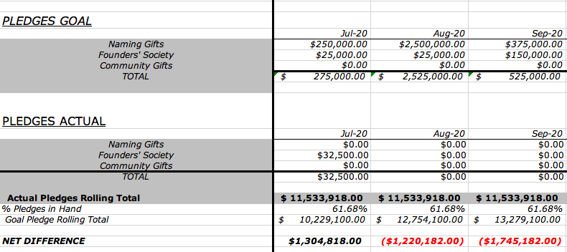
Note:
1. $250,000 naming gift came in during June, a month earlier than projected.
2. Brick goal has moved to the cash report, because it is a cash transaction.

Slide 4
July Cash Activity
Total Cash Activity in July: $63,415.93
Pledge payments totaling $32,415.93
Goal of $750
Brick Sales totaling $31,000.00
Goal $50,000

Slide 5
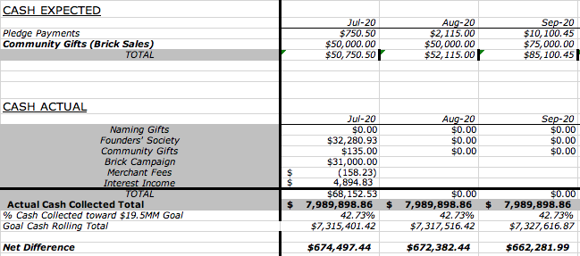

Slide 6

WHERE ARE WE?
Campaign Totals July 31, 2020:
Pledges and cash from brick sales: $11,564,918
Land: $ 1,500,000
Bond: $ 4,000,000
Total raised toward $25 million: $17,064,918
Interest earned to date: $ 170,331
Total asset: $17,235,249

Slide 7
WHERE ARE WE GOING?
68% TO GOAL OF $25 MILLION
 | AUGUST | SEPTEMBER | OCTOBER | NOVEMBER | DECEMBER | JANUARY | FEBRUARY | MARCH | APRIL | TOTAL
LEAD GIFTS | $2,500,000 | $375,000 |  |  | $2,750,000 |  |  |  | $1,000,000 | $6,625,000
FOUNDERSSOCIETY GIFTS | $25,000 | $150,000 | $100,000 | $125,000 | $125,000 | $100,000 | $100,000 | $100,000 | $100,000 | $925,000
PUBLIC PHASE (BRICK SALES AND OTHER GIFTS LESS THAN $2,500) | $50,000 | $75,000 | $50,000 | $50,000 | $50,000 | $50,000 | $50,000 | $50,000 | $50,000 | $475,000
TOTAL GOAL | $2,575,000 | $600,000 | $150,000 | $175,000 | $2,925,000 | $150,000 | $150,000 | $150,000 | $1,150,000 | $8,025,000

Slide 8
HOW ARE WE GOING TO GET THERE?
CAMPAIGN STRUCTURE
Lead Gifts
Local and Regional Businesses
Families and Individuals
Public Campaign

Slide 9
HOW ARE WE GOING TO GET THERE?
CAMPAIGN TOOLS
Lead Gift Stewardship
  Lead and Naming Gifts that will fund $6.5 of remaining goal
The Founders’ Society
  Gifts of $2,500 or more that will fund $1 million of remaining goal
The Aquesta Challenge
  Matching gift of $250K driving business contributions
The Brick Campaign
  Public sales initiative to fund $500K in revenue
Virtual and Small Events
  Support asks in every category
Marketing Campaign
  Push brick sales and increase public awareness

Slide 10
HOW ARE WE GOING TO GET THERE?
BRICK CAMPAIGN
Founders’ Society (185 Members)
Virtual Cocktail Hour Launch July 21
About 45 Founders’ Society households attended
14 Bricks sold
Goal for July: $50,000
Actual achieved: $31,000

Slide 11
HOW ARE WE GOING TO GET THERE?
BRICK CAMPAIGN
Virtual Cocktail Hour Launch
Lessons Learned:
Even for a virtual event, guests need lead time of 2 -3 weeks
A hard ask is needed every time
Brick purchases aren’t instant – potential donors need time to think about what they want, what they want to engrave, etc.
A personal ask makes the difference

Slide 12
HOW ARE WE GOING TO GET THERE?
BRICK CAMPAIGN:
Friends and Family Campaign:
Open brick sales by special invitation to friends of Founders’ Society members during the month of August
Supported by:
Personal email from Jean Bock
Personal invitation from board members
Personal invitation from Brick Task Force members
Founders’ Society newsletter

Slide 13
HOW ARE WE GOING TO GET THERE?
BRICK CAMPAIGN
Brick Task Force Strategy:
Target Four Core Audiences:
Small local businesses
Civic Organizations
Neighborhood Associations
Small Arts Organizations and Providers

Slide 14
HOW ARE WE GOING TO GET THERE?
EVENTS
Virtual Events
  Founders’ Society Brick Launch
  Business After-Hours
  Porch Parties
  Gatherings of 10 or fewer at private residence, neighborhood green, business, etc. Outdoors or with outdoor option.
  Chef-Curated Dinners
  Dinner for 8 – 10, indoors or outdoors as people are comfortable. Chef-prepared dinner provided.
  Living Room Sessions
  Gathering of 10 people, outdoor element, live or virtual entertainment, lecture, or behind the scenes tour. Food provided.
  Bring a Donor to the Table
  Reserved table at restaurant, one-on-one ask.

Slide 15
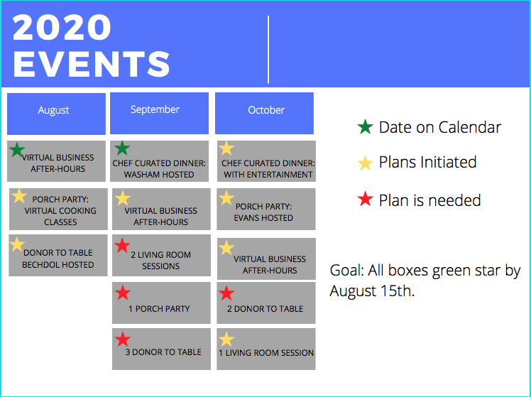
HOW ARE WE GOING TO GET THERE?
Virtual and Small Events

