Slide 1
September, 2020 Executive Committee Meeting

Slide 2
August Pledge Activity
10 new Founders’ Society pledges totaling $170,000 on a goal of $25,000
Expected lead gift did not come in, but is still in discussion

Slide 3
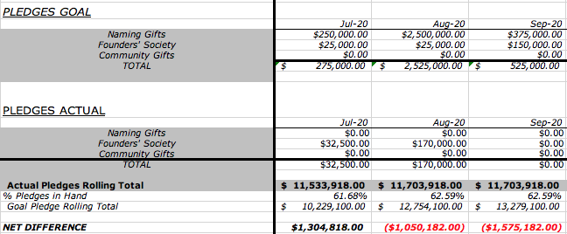

Slide 4
August Cash Activity
Expected August pledge payments: $2,115
Actual August pledge payments: $62,989.49
Projected brick contributions: $50,000
Actual gross brick contributions from Neon: $52,509.58
Notes:
Contributed credit card fees = $509.58
Financials will reflect payments received by bank

Slide 5
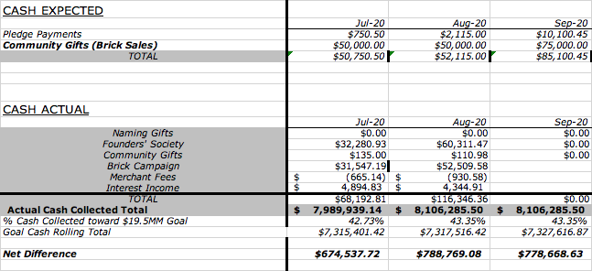

Slide 6
WHERE ARE WE?
Campaign Totals August 31, 2020:
Total Pledges: $11,703,918
Total Net Revenue Bricks: $ 83,000
Land: $ 1,500,000
Bond: $ 4,000,000
Total Raised toward $25 million: $17,286,918
Interest Income to Date: $ 174,676

Slide 7
WHERE ARE WE GOING?
 | AUGUST | SEPTEMBER | OCTOBER | NOVEMBER | DECEMBER | JANUARY | FEBRUARY | MARCH | APRIL | TOTAL
LEAD GIFTS | $2,500,000 | $375,000 |  |  | $2,525,000 |  |  |  | $1,000,000 | $6,400,000
FOUNDERSSOCIETY GIFTS |  | $150,000 | $100,000 | $125,000 | $125,000 | $100,000 | $100,000 | $100,000 | $100,000 | $900,000
PUBLIC PHASE (BRICK SALES AND OTHER GIFTS LESS THAN $2,500) |  | $75,000 | $50,000 | $50,000 | $50,000 | $50,000 | $50,000 | $50,000 | $50,000 | $425,000
TOTAL GOAL | $2,500,000 | $600,000 | $150,000 | $175,000 | $2,700,000 | $150,000 | $150,000 | $150,000 | $1,150,000 | $7,725,000

Slide 8
HOW ARE WE GOING TO GET THERE?
Public Phase Launched
Brick Campaign Task Force strategically targeting audiences
Marketing Campaign Underway
Demolition Event Accomplished
2. Founders’ Society Gifts on Goal
3. Strategy for Remaining $6.4 million

Slide 9
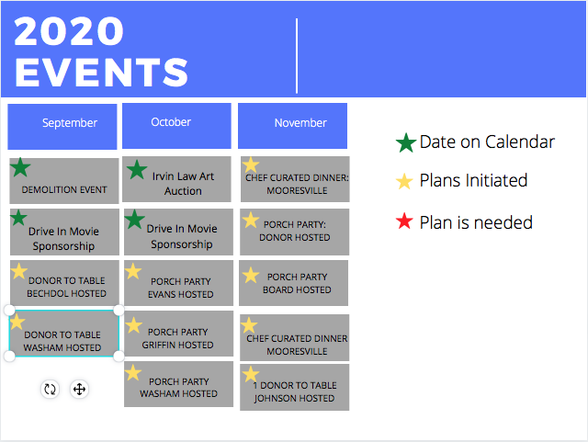
HOW ARE WE GOING TO GET THERE?
Virtual and Small Events

Slide 10
Brick Task Force/ Campaign Cabinet Recommendations:
ACTION NEEDED
1. Proposed policy for receiving checks:
“After 30 days if payment has not been received your brick(s) will be returned to inventory. If you would like to make special arrangements, please contact the Development Department at 980-689-3101.”
2. Brick Task Force recommends that all engraving be centered on the bricks.

