Slide 1
The Cain Center for the Arts
(Final)
HR 671 - Katie Rogers

Slide 2
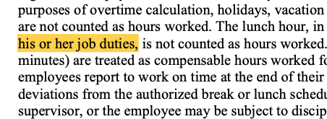
Inclusivity in language: Update his/hers to be his/hers/theirs to promote overall inclusion
A lot of areas were left up to discretion - we need to be careful with this and need to have parameters established so there is equity and equality. Decisions must be made on quantitative data and be evidence based. All decisions must also be well documented.
Suggestions for Changes to the Employee Handbook

Slide 3
Reimbursements section on page 9 - When the new system can handle this, it would need to be edited to reflect the process within the HRM system
Time Recording/Time off section page 8 - When new timeclock system is established this section will need to be edited to reflect the process within the HRM system
Suggestions for Changes to the Employee Handbook

Slide 4
Holidays section on page 11 - If operationally achievable I suggest moving towards offering 12 days off for paid holidays. Another option could be that each individual employee chooses which 10 days to have paid instead of everyone voting for the 10. Continue to emphasize that days can be “switched” to accommodate other religious holidays to ensure inclusivity.
Suggestions for Changes to the Employee Handbook

Slide 5
Office handbook
Most of the systems (especially ADP or Paychex) can handle keeping the office handbook in the files as well as the forms within that would need to be filled out and submitted.
Suggestions for Changes to the Employee Handbook

Slide 6
Benefits additions:
403B or 401K offerings
403(b) VS 401(k): Comparing retirement plans for non-profits.
Pros And Cons Of 403(b) Plans For Educators And Non-Profit Workers
403(b) vs. 401(k): What’s the Difference?
Family Leave
How Small Companies Can Offer Great Paid-Leave Programs
NC Paid Family Leave Insurance Act
Paid Family Leave: Balancing Benefits and Costs
Allowing employees and their loved ones to attend events and classes for free
Suggestions for additions

Slide 7
1099/Contractor:
Checklist: Utilizing Independent Contractors
A Handbook for 1099 Contractors – What Goes In and What Should Stay Out
Example of an Independent Contractor Agreement
Example of Cain Center for the Arts Independent Contractor Handbook
Once center is built work to include typical building hours of access, parking, and entrances
Independent Contractor Handbook

Slide 8
At the Cain Center for the Arts we strive for equity and equality in all we do. When making employment decisions (i.e Hiring, Rejecting Candidates, Firing, Probation, Performance Improvement Plans, Employee sanctions, etc) we must ensure that the process is well documented.
Describe the organization's expectations. Make them clear and concise.
Describe the behavior or performance, not the individual. (In the case of recruitment, describe the fit according to the job description. Avoid writing anything related to protected classes such as: Age, Race,Marital Status, Family Status, Gender, Sexual Orientation, etc)
Include the employee’s explanation for why the issue is occurring
Prepare a detailed action plan with specific deadlines
Clearly State the consequences if the behavior or poor performance continues.
Avoid vague phrases that could provide grounds for discrimination lawsuits
Document all decisions with the mindset that a third party will be reviewing it.
Documentation Best Practice

Slide 9
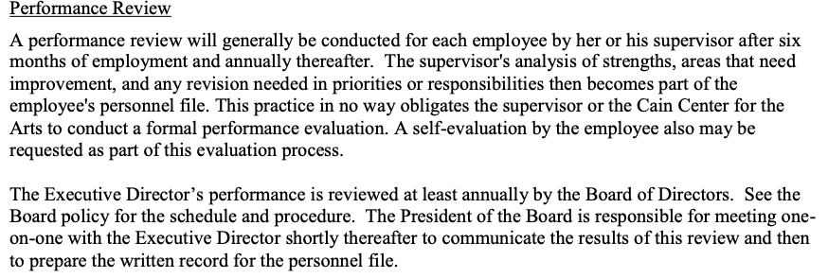
Performance Review page 15 - I suggest implementing a 360 degree feedback review. Each FTE and randomly assigned board and business partners would fill out a survey for the other FTE including the Executive director. Those doing the review and follow up would be a board member not involved in the process. These would be kept anonymous. They should be done once a year regardless of how long the employee has been with the organization.
Example
If there is follow up needed for the employee it will be up to Board and ED discretion whether a coach is needed or a performance improvement plan.
Suggestions for Changes to the Employee Handbook

Slide 10
Drug and alcohol free workplace policy page 16 - I am afraid this is not specific enough in regards to the alcohol consumption “in moderation”. I suggest making a drink limit for the events.
Responsible use of Alcohol Policy
https://www.lawyers.com/legal-info/labor-employment-law/human-resources-law/employer-liability-for-alcohol-injuries.html
Conflicts of interest policy page 17 - These are kept electronically. A new HRM system can track scanned in documents.
Suggestions for Changes to the Employee Handbook

Slide 11
Offerings:
HR
Payroll
Benefits
Talent Management
Workforce Management
Services
Cost: Contacted for Quote
Packages:
Ceridian Dayforce Packages
Ceridian Info Sheet
Potential HRM Systems

Slide 12
Offerings:
Payroll
Time and Attendance
Talent
Benefits
HR Outsourcing and PEO
HR Services
Integrations
ADP Marketplace
Cost: Admin fees and % fee of payroll
Packages:
ADP Packages
ADP Total Source
Total Source
A Guide to the Benefits
Solutions
Potential HRM Systems

Slide 13
Offerings:
Payroll Services
Human Resources
Time and Attendance
401K and Retirement
Health and Benefits
Cost: Contacted for Quote
Packages:
Paychex Packages
Potential HRM Systems (Katie’s Choice)

Slide 14
Proposal
HR Solutions Brochure
HR Solutions Wheel of Services
Paychex

Slide 15
Largest provider for HR Services in the under 50 employees space
ASO (Administrative Services Organization)
Not under federal ID #
Acting under EIN
More cost effective
More flexibility
No minimum for number of employees
Project based (can be month to month)
Local HR consultant (Amy, Charlotte based, monthly touch points)
Can handle recruiting, hiring, onboarding, handbooks, retirement, orientation, attorney review every 6 months
Flex is cloud based
In house 401k administrator
Owns their own health insurance
Full auto onboarding
Time clock: clock in /clock out
Recruiting can be an automated system
Paychex

Slide 16
Paychex has a COVID-19 team
OSHA - infectious disease policy
Proactive approach to HR issues
Benefit Perks:
No admin fees with 401K
Low expense ratios (over 9000 options)
You can put a financial advisor on the plan
No contribution requirement for organizations
Health Insurance Perks:
Organization can track waiting period
Full service - handles terminated employees
Medical, Dental, Vision, Life, Disability (Quotes within 2-3 days)
FSA/HSA
EAP - Next Gen
Employee Discounts
Financial Wellness Program
Paychex

Slide 17
Very easy set up
Unlimited document storage
Custom Reporting
Employee portal
Cost:
Base Fee: $373.80
W2 Employee: $12.36
1099 Employee: $2.20
Around $12,000 annually (this is with unlimited access to the local consultant)
Payroll would be less than $2,000 per year
Paychex

