Slide 1

Cain Center for the Arts
Phase 2: Technology Assessment & Roadmap
Fall 2021

Slide 2
Table of Contents
Topic | Slide #
Project Overview 3 - 8
Overview & Approach | 3
Maturity Models | 4 - 5
Executive Summary & Timelines | 6 - 7
Current State Recap | 8
Recommendations 9 - 38
Infrastructure | 9 - 12
IT Support & Maintenance | 13 - 21
Software Applications | 22 - 27
Hardware | 28 - 31
Business Continuity Management | 32 - 38
Appendix 39 - 42

Slide 3
Overview & Assessment Approach
The goal of this presentation is to provide Cain Center for the Arts with a deeper understanding of existing gaps in their current technology and recommend future technology solutions to address those gaps, preparing the Cain Center for success in the future.
Information Technology (IT), is used by the Cain Center to support its mission in both business & outreach operations; IT also supports the daily program functions of the Cain Center, allowing for efficient and streamlined management of the non-profit.
The following slides, developed by our collaborators at Apparo Group, showcase a maturity model. This model details the current status of the Cain Center’s IT structure, readiness, and any gaps related to IT infrastructure. We will use this guide to help assess priority areas where gaps may exist in the Cain Center’s current IT plan & infrastructure.
The technology assessment & roadmap will:
Assess current-state technology at the Cain Center (e.g., existing software, current website security)
Provide cost-conscious strategy for future technology solutions (e.g., network design, refreshed laptops)
Showcase a timeline for each specific workstream solution (e.g., infrastructure, hardware)
Disclaimer: It is understood and agreed that Deloitte Consulting’s services under the previously signed Engagement Letter may include advice and recommenda­tions, but all decisions in connection with the implementa­tion of such advice and recommendations shall be the sole responsibility of, and made by, the Cain Center management team.

Slide 4
Maturity Model
Illustrative
Support & Maintenance
Hardware, Servers, & Devices
Skilled Staff
Data
Backups
Website
Reporting
Security
Internet
Phone System
Assessment Scale
Business
Applications
Strategic
Proactive
Stable
Technology Plan
Reactive
Technology Budget
Deficient
Technology Policies

Slide 5
Maturity Model
Illustrative
Level 1
Level 2
Level 3
Level 4
Level 5
Deficient
Technology infrastructure is outdated
No IT Support
No data backups
No technology plan or budget
Manual or excel based processes
0% to 20% of staff have skills needed to do their job efficiently
No reporting
No website
No technology policies in place
Reactive
Technology infrastructure outdated but stable
Limited technology support for break fix issues
Data backs ups are ad hoc back up to external drive
No formal technology plan but break fix projects underway
Small technology budget imbedded with other budgets in organization
Operating on unsupported versions of business applications
20% to 40% of staff have tech skills needed to do their job efficiently
Outdated and unstable website
Reporting very manual with data clean up required each time
Technology policies out of date
Stable
Current and stable infrastructure
Technology support adequate for break fix and ad hoc maintenance
Regularly schedule back up to external drive
Technology plan documented for break fix items and maintenance only
Small technology budget for only break fix or maintenance items
Current versions of business applications
40% to 60% of staff have tech skills needed to do their job efficiently
Outdated but stable website
Automated reporting with useable information
Technology Policies up to date
Proactive
Current, stable infrastructure with regularly scheduled maintenance and support
Regularly scheduled maintenance and support
Regularly scheduled back up
Technology plan only considers short term (6 months)
Technology budget for short term (6 month) tactical projects
Operating on current versions and regularly scheduled maintenance and staff working on same or integrated applications or planning to move to same or integrated applications
60% to 80% of staff have skills needed to do their job efficiently with plan to educate remaining staff
Current and stable website
Automated reporting with useable information, historical data available
Technology policies up to date and reviewed to ensure adherence
Strategic
Regularly scheduled maintenance and support and future minded goals set
Regularly scheduled maintenance and support provided; Plan for IT support included in any future tech changes
Data stored on cloud with backups
Current Executive Sponsorship of Tech Plan and project plan to implement
Executive sponsorship of current and future technology budget
Appropriate applications implemented to manage and share data for each component of the organizations and staff working on same or integrated applications
80% to 100% of staff have skills needed to do their job with plan to educate remaining staff
Current and stable website with plan to keep up to date
Automated reporting with useable info, Strategic / dynamic reporting to understand what was successful and how you can improve for the future
Policies up to date, reviewed ongoing and re-evaluated based on change in goals
Get Stable & Secure
Optimize Mission Delivery
Transform Your Work

Slide 6
Executive Summary: Timeline / Phases
Note: Timeline is illustrative, with emphasis on decision planning; decision-making process would occur over a similar length of time after the start of the Cain Center’s new fiscal year in July 2022.
2022 |  |  |  |  |  |  |  |  |  |  |  | 2023
Jan | Feb | Mar | Apr | May | Jun | Jul | Aug | Sept | Oct | Nov | Dec | Jan | Feb | Mar
1
2
3
4
5
Key Observations & Recommendations
IT Support & Maintenance
Software Applications
Business Continuity
1
Infrastructure
2
3
4
Hardware
5
Use of new-surplus or refurbished items to reduce costs
300mbps or 500mbps bandwidth plan
Guest Wi-Fi separately-named, 2.4ghz band, with simple password protection
Utilize checklist and details to find an MSP provider recommended by Apparo
Weekly cadence of data backups at minimum
Work with MSP to create IT security guidelines and trainings
Purchase McAfee Anti-Virus support
Add security service to website
Test firewall quarterly
Utilize Microsoft Office as the go-forward software integration software application
Utilize Adobe DC for Teams for PDF solutions
Utilize Microsoft SharePoint going forward and retire Egnyte subscription
Maintain CRM memberships unless in-house solution can be created
Pair Dell Laptops with a hybrid approach to peripherals & accessories to maximize cost savings
Partner with an MSP to “right-size” copier & VOIP-technology needs and leverage non-profit GPOs to reduce copier costs
Partner with MSP to develop Disaster Recovery and Business Continuity policies
Implement a security training policy for both digital and physical threats for all Cain Center staff

Slide 7
Note: Timeline is illustrative, with emphasis on decision planning; decision-making process would occur over a similar length of time after the start of the Cain Center’s new fiscal year in July 2022.
Tech Road Map
 | 2022 |  |  |  |  |  |  |  |  |  |  |  | 2023
 | Jan | Feb | Mar | Apr | May | Jun | Jul | Aug | Sep | Oct | Nov | Dec | Jan | Feb | Mar
Infrastructure
IT Support & Maintenance
Software Applications
Hardware
Technology Policies
Network Design Phase
Network equipment purchased with MSP input and installation & calibration expected to last until Q3 2022
Bandwidth Selection & Guest Wi-Fi
Cain Center selects desired bandwidth speeds, entering contract with ISP & discusses capacity to control Guest Wi-Fi offers with ISP/MSP
MSP Identification, Offering Discussion, Contract Signing, and Service Delivery
Cain Center selects & partners with an MSP to review Network designs, Software & Hardware recommendations,
as well as discuss additional offerings/policies/trainings
Data Backup Recommendations
Cain Center discusses and aligns on an appropriate methodology for regular data backups with the MSP
Staff Security Training/Cloud VPN
Cain Center discusses and aligns on an appropriate Staff Security trainings & VPN applicability with the MSP
Anti-Virus Selection
Cain Center discusses and aligns on an appropriate Anti-Virus software selection based on MSP discussion
Firewall Testing
Cain Center aligns with MSP on appropriate cadence of firewall testing (quarterly, etc.),
as well as additional website protection recommendations (would repeat monthly/quarterly/etc.)
Software Program (Office Suite
& Supporting Software)
Cain Center aligns with MSP on recommended daily software (Office Suite) and supporting software
(PDF reader, etc.) for purchase & implementation
Software Consolidation
Cain Center discusses possible software for consolidation with MSP, based on Deloitte recommendations
to determine if there are additional areas of consideration
Hardware Selection
Cain Center discusses Laptop, VOIP, Printer, and other hardware selections with MSP partner to align on the
best fit for its needs, and works with MSP or GPO to procure
Disaster Recovery
Cain Center aligns with MSP on recommended disaster recovery plan
Business Operations
Cain Center aligns with MSP on business operations best practices (e.g., business service disruption)
Security Policies
Cain Center aligns with MSP on access and physical security policies

Slide 8
Current State Technology: An Overview
Technologies | Description | Use | Current Cost
Hardware | Laptops | Day-to-Day Business functions | Current mix is personal or loaned
 | VOIP Phone | Day-to-Day Business calls | Owned
 | Printer | Various business needs | Owned, no cost
Programs | MS Office Business Pro 365 | Day-to-day use of traditional Office Suite programs | Free (10 License Max)
 | MS Power BI | Additional use with day-to-day Office Programs | Free (10 License Max)
 | Google Workspace | Used in conjunction with Gmail to map calendars and manage customer/client data | $576/yr. ($6/user/month)
 | Egnyte | Current Cloud Server for Cain Center | $540/yr. ($9/user/month)
 | MailChimp | Used to create bulk-email blasts | $3,588/yr.
 | NeonOne | Client CRM database management | $3,979/yr.
 | CivicRec | Class & Event registration, e-commerce | $4,230/yr.
 | WordPress | Cain Center website is built via this software | Free
 | Doodle | Used as a meeting scheduler & for surveys | Free
 | Zoom Pro | Used for Virtual Meetings | $180/yr.
In total, the Cain Center currently spends over $13,000 per year on its various, fragmented technology solutions.

Slide 9
Infrastructure

Slide 10
Infrastructure Summary
Note: Timeline is illustrative, with emphasis on decision planning; decision-making process would occur over a similar length of time after the start of the Cain Center’s new fiscal year in July 2022.
2022 | Feb | Mar | Apr | May | Jun | Jul | Aug | Sept | Oct | Nov | Dec | 2023 | Feb | Mar
Jan | Feb | Mar | Apr | May | Jun | Jul | Aug | Sept | Oct | Nov | Dec | Jan | Feb | Mar
Network Design Phase
Network equipment purchased with MSP input and installation & calibration expected to last until Q3 2022
Bandwidth Selection & Guest Wi-Fi
Cain Center selects desired bandwidth speeds, entering contract with ISP & discusses capacity to control Guest Wi-Fi offers with ISP/MSP
DETAILS
KEY RECOMMENDATIONS
Network Design
Bandwidth & Guest W-Fi
Infrastructure Hardware
The firewall, router, switch, and a 50ct package of 7ft cabling will cost $1,209; this cost could increase based on the amount of cabling required after discussing network design with an MSP
Wi-Fi hardware
The NAS, wireless controller, and 20 APs will cost $5,316, this cost could increase if more APs are needed in the final design
Total Pricing
The full cost for hardware, before bandwidth access, is $6,525; assuming a 500mbps access cost of $1,200, the total cost for the Cain Center would be $7,725
Note: This cost estimate can rapidly increase depending upon how network hardware is sourced, or if an ISP-leased option is selected
Bandwidth
Deloitte recommends the Cain Center subscribe to a 300mbps or 500mbps bandwidth plan
Guest Wi-Fi
Guest Wi-Fi should be broadcast on a separately-named, 2.4ghz band, with simple password protection
Discuss with MSP provider the ability to throttle guest access speeds
Notes:
Tags: process, business case, visual, process flow, thumbnails

Slide 11
Infrastructure: Network Design
Deloitte recommends:
Hardware | Description | Pricing
Firewall | Cisco 5506X-series Firewall (or similar model), offering URL filtering capabilities along with VPN functionality | $495
Router | Cisco 2900-series Wireless Router (or similar model), giving the ability for the network to handle 300-500mbps bandwidth speeds | $320
Switch | Cisco 1000-series 48-port Gigabit Ethernet Switch (or similar model), to support Aps throughout the Cain Center | $338
Wireless Controller | Cisco 2500-series Wireless LAN controller (or similar model), allowing for remote management of up to 25 APs | $637
Access Points (APs) | Cisco Aironet 1850-series AP (or similar model), allowing for dual-band 2.4ghz & 5.0ghz simultaneous broadcast: estimate 20 AP minimum | $3,580 ($170/ea.)
Network Attached Storage (NAS) | Western Digital MyCloud EX4100 (or similar model), featuring a 24TB capacity for the Cain Center to maximize on-site cloud storage | $1,099
Cabling | CAT6 model low-voltage (LVC) cabling is recommended for this network design: estimated amount required will vary based upon final design | $56 for 50ct. package of 7ft cables
Note: The pricing quoted is reflective of new-surplus or refurbished items, as new items from Cisco have a substantially higher retail price. Additionally, more cabling/APs (or more powerful APs) may be required depending upon General Contractor/Sub-Contractor recommendations as well as placement of desired hard-access points.

Slide 12
Infrastructure: Bandwidth & Guest Wi-Fi
Topic | Pricing
Bandwidth | $1,200/yr. based on Spectrum Wireless Quote for 500mbps
Guest Wi-Fi | Guest Wi-Fi would be a function of the network design, and not specifically have an attributable cost
Deloitte recommends the Cain Center subscribe to a 300mbps or 500mbps bandwidth plan because:
This will allow for the full utilization of Microsoft Teams, Cloud storage, and larger remote-format meetings without a diminished network quality
Higher speeds will also give the Cain Center the option for future remote class offerings, courses, or other digital community engagement activities
Deloitte recommends Guest Wi-Fi be broadcast on a separately-named, 2.4ghz band, with simple password protection
In addition, the Cain Center should discuss with MSP (once selected) about the potential to “throttle” guest access speeds to 50-100mbps, to prevent network slowdowns for Cain Center staff, and to reduce usage of devices during productions

Slide 13
IT Support & Maintenance

Slide 14
IT Support & Maintenance Summary
Note: Timeline is illustrative, with emphasis on decision planning; decision-making process would occur over a similar length of time after the start of the Cain Center’s new fiscal year in July 2022.
2022 | Feb | Mar | Apr | May | Jun | Jul | Aug | Sept | Oct | Nov | Dec | 2023 | Feb | Mar
Jan | Feb | Mar | Apr | May | Jun | Jul | Aug | Sept | Oct | Nov | Dec | Jan | Feb | Mar
MSP Identification, Offering discussion, Contract signing, and Service delivery
Cain Center selects & partners with an MSP to review Network designs, Software & Hardware recommendations, as well as discuss additional offerings/policies/trainings
Data Backup Recommendations
Cain Center discusses and aligns on an appropriate methodology for regular data backups with the MSP
Staff Security Training/Cloud VPN
Cain Center discusses and aligns on an appropriate Staff Security trainings & VPN applicability with the MSP
Anti-Virus selection
Cain Center selects & partners with an MSP to review Network designs, Software & Hardware recommendations,
as well as discuss additional offerings/policies/trainings
Firewall Testing
Cain Center aligns with MSP on appropriate cadence of firewall testing (quarterly, etc.) as well as additional website protection recommendations (would repeat monthly/quarterly/etc.)
KEY RECOMMENDATIONS
MSP Checklist
3rd Party IT Service Partner / MSP
Data-Backups
Staff Trainings / VPN guidance
Anti-Virus
Firewall Testing
Collect Basic Info
Sign the contract
Welcome the new MSP
Meet the team
Make planning documents
Provisioning
RMM Setup
MSP Conduct Training
Go-Live
Check-In
Vet both MSP options recommended by Apparo to understand customized pricing, network design, hardware offerings, training, etc.
Purchase and include a 24TB NAS drive on-site at the Cain Center to better allow for local, large or sensitive file storage, expected cost ~$1,100
At least weekly data backups
Work with an MSP partner to develop up-to-date IT security practices as well as phishing detection and spoofing-awareness training
Purchase the McAfee anti-virus offering to allow for a higher number of covered devices at a lower cost - $160/yr. for 10 users
Discuss anti-virus offerings with an MSP to understand if there are more tailored options available
Add security service to the website security plan -$14.99/mo.
Complete a website firewall test at least once quarterly or when any change is added to interface of the website.
Notes:
Tags: process, business case, visual, process flow, thumbnails

Slide 15
IT Support: MSP Checklist: 1 of 2
MSP Checklist | Description | Major Components | Recommendation
Collect Basic Information | Collect basic information about the MSP and the infrastructure that the MSP uses. This helps when getting the Service level agreement (SLA) prepared by the MSP | Things to Collect: Company Name, Contact Name, Service Tier Things to Know: # of Servers, Cost of Servers, Cost of Workstations, Managed Services Required | Deloitte recommends Cain Center for the Arts contact an MSP and collect this basic information
Sign the Contract | Once the MSP understands the Cain Center needs, the MSP will be ready to generate a contract (SLA). Sign the contract once due diligence by appropriate management | Service Level Agreement | Deloitte recommends Cain Center for the Arts sign the contract once needs are met
Welcome the New MSP | Once an SLA contract is signed, ensure a "welcome document“ is sent to the Cain Center. This helps build the relationship but also provides the customer with important information about your company | Welcome Document | Deloitte recommends Cain Center for the Arts ask for the Welcome Document from the MSP
Meet the Team | During the onboarding process with the MSP, its good to have the Cain Center with the MSP either in person or via phone. A meeting helps to establish a stronger connection with the client | Basic Agenda: Technology Goals, Internal Use Policy, Anti-Virus, Anti-Spam, Website Hosting | Deloitte recommends Cain Center for Arts have a basic meeting with the MSP
Make Planning Documents | Planning documentation for the MSP will help the Cain Center stay organized and ensure the MSP doesn’t overlook any needed services | Project Task List & Project Schedule | Deloitte recommends Cain Center for the Arts have planning documents prepared for the MSP

Slide 16
IT Support: MSP Checklist: 2 of 2
MSP Checklist | Basic Information | Major Components | Recommendations
Provisioning | Provisioning, MSP integrating their systems in the Cain Center | MSP should set up or at least acknowledge: Professional Services Automation, SLA agreement, new business email announcement, obtain all contracts (hardware & software, review firewall, change admin passwords | Deloitte recommends Cain Center for the Arts understand the provisioning from the MSP
RMM Setup | Remote monitoring and management, or RMM is critical for enabling the MSP to manage the Cain Centers infrastructure remotely and respond quickly when you are offsite | Install RRM agents on MSP servers, workstations and mobile devices. Make sure RMM tool is compatible and test/ monitor alerts ensure they work. | Deloitte recommends Cain Center for the Arts to ask the MSP if a RMM setup available
MSP Conduct Training | Make sure MSP attempts to coordinate a webinar or schedule on-site training. Check for incentives (cool stickers / office stuff) from the MSP since the team is devoting time for the training. | Webinar or Schedule on-site training | Deloitte recommends Cain Center for the Arts conduct training for staff using the MSP's software
Go Live | Final Step in the onboarding process is to take everything live with the MSP. Make sure the onboarding MSP team sends an email stating that the SLA has gone live, and expectations are clear. | Email Confirmation on Go Live | Deloitte recommends Cain Center for the Arts make sure the MSP sends an email confirmation stating that the SLA has gone live
Check in | Even after the onboarding is complete , the relationship with the new MSP is just beginning. It is important to continue to do your utmost to avoid any hiccups or misaligned expectations. | Relationship Management | Deloitte recommends Cain Center for the Arts establish relationship management with the MSP

Slide 17
IT Support: 3rd Party IT Service Partner / MSP
MSP | Description | Service Offerings | Pricing
Charlotte Computer Partners | Founded in 2000, with over 20 years of experience in Charlotte for IT service needs. Credentialed by multiple software & hardware manufacturers | Cloud Solutions Managed Services Network Security VOIP Solutions Cyber Security Awareness Training | Variable; depending upon the Cain Center’s needs
CLT Networks | Experienced MSP that services HOAs, apartment complexes, hotels, and smaller offices around the Charlotte area | Setting up Internet access Network Design & Installation Traffic management Network monitoring and management Online backups E-mail, web, & DNS hosting (website) | Variable; depending upon the Cain Center’s needs
Deloitte recommends:
The Cain Center engage in conversations with both vetted, Apparo recommended, MSPs to understand potential customized pricing, considering other recommendations in the presentation such as network design & hardware offerings as well as inquire about various training offerings that could be provided to the Cain Center staff.
Note: A blended approach may work best, depending upon if CCP or CLT-N do not have 100% service overlap

Slide 18
IT Support: Data Backups
Data Backup | Description | Pricing
Microsoft OneDrive | Included with Microsoft Office, Microsoft SharePoint is a Cloud-based storage solution that can be set to automatically sync & backup a workstation’s files on a regular basis | Included with Office 365 Business Professional, currently up to 10 licenses are allowed for free to Non-Profits ~1TB of Storage initially offered
Cain Center NAS | Network-attached storage (NAS) is an on-site, centralized storage device that is connected to the local network via ethernet ports, allowing for on-site shared drive storage functionality, augmenting cloud storage abilities, and is often used to keep more sensitive/ sizable files “local” versus in the cloud | $1,099
Deloitte recommends:
Backing up Microsoft OneDrive at least weekly, however, OneDrive can perform daily (or near-instant) backups of shared files depending on the Cain Center needs
The purchase & inclusion of a 24TB NAS drive on-site at the Cain Center to better allow for local, large or sensitive file storage with data backups scheduled at least weekly depending on the Cain Center needs.
Note: Once the Cain Center selects an MSP, there may be additional or alternative Data Backup sources & processes to discuss, based on MSP input

Slide 19
IT Support: Staff Training & Cloud/VPN Guidance
Trainings | Description | Benefits
Phishing Awareness | Phishing attempts often utilize spoofing techniques to gain access to privileged information, such as an email that appears to be from a financial institution requesting verification of log-in credentials | Training employees to recognize phishing attempts will increase the security of the organization, as employees are often the “last line of defense”
Spoofing Awareness | Spoofing is often a disguised communication i.e., a website URL with a single letter changed, or an internal email, designed to manipulate a user into downloading infected software, or disclose sensitive information | Training employees to better identify attempts at spoofing will increase the security of the organization, as employees are often the “last line of defense”
IT Security Best Practices | IT Security best practices can encompass technology use (e.g., password requirements), access requirements (e.g., VPN usage when remotely working), and an array of other offerings (e.g., never using personal email to send sensitive files) | By implementing an array of technology use best practices, opportunities for security breeches or data loss are minimized
Deloitte recommends:
The Cain Center work with an MSP partner to develop phishing-detection and spoofing-awareness training for all staff members
The Cain Center work with an MSP partner to develop up-to-date IT security practices for all staff members

Slide 20
IT Support: Anti-Virus
Anti-Virus Brand | Description | Pros | Cons | Pricing
McAfee | McAfee Total Protection Ultimate is a full suite of anti-virus, file-shredder, firewall, VPN, & security monitoring solution | All-in one package that allows for coverage of 10+ devices in addition to mobile device coverage Firewall included | Limited to 5 devices if you purchase any lower-level software package Some benefits may be duplicative (access controls, etc.) with ISP/MSP offerings | $159.99/yr.
Symantec (Norton) | Norton 360 with LifeLock provides All-In-One, comprehensive protection for devices, identity, and online privacy; this includes LifeLock identity theft protection and a secure VPN when connecting through public Wi-Fi. | Firewall included 500GB Cloud Backup included | Similarly priced offering (not shown) only allows for 5 devices, requiring the Cain Center to buy the more expensive offering Multiple benefits (401k, parental controls, etc.) are not of value to the Cain Center | $349.99/yr.
Deloitte recommends:
The Cain Center purchase the McAfee offering, as it allows for a higher number of covered devices at a lower cost, however, the Cain Center should discuss Anti-Virus offerings with an MSP to understand if there are additional, more tailored offerings available

Slide 21
IT Support: Cain Center Website Firewall Test + Recommendation
Issue Type | Description | Severity Level
Burp Suite Scanner Report | Strict Transport Security is not enforced when application fails to prevent users from connecting to it over unencrypted connections. An Attacker able to modify a legitimate user's network traffic could bypass the application's use of SSL/TLS encryption and use the application as a platform for attacks against its users. To exploit this vulnerability, an attacker must be suitably positioned to intercept and modify the victims network traffic. This scenario typically occurs when a client communicates with the server over an insecure connection such as public WIFI, or corporate that is shared with a compromised computer. | LOW Impact Level
Deloitte recommends:
Cain Center for the Arts add the $14.99 security service to the website security plan.
A Cain Center Website firewall test be completed at least once on a quarterly basis or when any change is added to the interface of the website.
Note: In the future network design, the Cain Center will have additional firewall protections via a hardware device, and depending upon the MSP selection, additional website security may be available through the MSP.

Slide 22
Software Applications

Slide 23
Software Applications Summary
Note: Timeline is illustrative, with emphasis on decision planning; decision-making process would occur over a similar length of time after the start of the Cain Center’s new fiscal year in July 2022.
2022 | Feb | Mar | Apr | May | Jun | Jul | Aug | Sept | Oct | Nov | Dec | 2023 | Feb | Mar
Jan | Feb | Mar | Apr | May | Jun | Jul | Aug | Sept | Oct | Nov | Dec | Jan | Feb | Mar
Software Program (Office Suite & Supporting Software)
Cain Center aligns with MSP on recommended daily software (Office Suite) and supporting software (PDF reader, etc.) for purchase & implementation
Software Consolidation
Cain Center discusses possible software for consolidation with MSP, based on Deloitte recommendations to determine if there are additional areas of consideration
KEY RECOMMENDATIONS
Microsoft Office vs. Google Workspace
PDFs & Digital Signatures
Software Consolidation
Software Consolidation: Bulk Email
Zoom Pro
Zoom should be kept, as it is utilized by the Cain Center BOD, and works in low bandwidth scenarios
Doodle
Doodle should be kept, as the core function of “viewing” calendar openings reduces emails for Cain Center ED
Egnyte
Microsoft SharePoint is included in MS Office, allowing the Cain Center to retire Egnyte and save $540/yr.
MailChimp
The Cain Center should maintain its relationship with MailChimp for bulk email needs
Neon CRM
Retain Neon CRM to all for continued management of Donor materials, allowing for separate email communications outside of MailChimp
Office Ticketing Software
Out of Scope
Microsoft Office
Cain Center should focus on a Microsoft-focused solution as non-profits receive up to 10 free business licenses before incurring a charge
Teams, OneDrive, SharePoint, & MS Office Suite have cloud/shared functionality for easy co-working
Google Workspace
Cancellation of Google Workspace results in savings of $576/yr.
Adobe Acrobat
Adobe DC Pro should be selected for 2-3 licenses, as it possess the broadest functionality, including some Adobe Sign features: estimated cost of $612/yr. for 3 users
Nitro-PDF / DocuSign
Nitro PDF & DocuSign should be avoided, as both would need to be purchased to have functionality like Adobe DC Pro
Notes:
Tags: process, business case, visual, process flow, thumbnails

Slide 24
Programs: Microsoft Office vs. Google Workspace
Software Suite | Description | Pros | Cons
Microsoft Office Business Premium 365 | More comprehensive platform -- provides full stack of technology solutions for every aspect of nonprofit operations & technology needs Looking to simplify decisions on where/how to store data/documents/file Has complex needs for managing and storing highly sensitive data Contains Multi-Factor Authentication (MFA) security options | Provides Email/Calendar integration with Virtual Meeting (Teams) Cloud Server (SharePoint) combined integration for easy movement between applications both on the desktop & in web-browsers | Best used within Microsoft-focused technology environment Depending upon client needs, some functions of Office may not be used and therefore, not add value
Google Workspace | Platform Agnostic Apps -- more like a collection of applications rather than a comprehensive solution; able to customize your collaboration solutions Decentralized approach to technology policies, high level of trust in users’ technology choices, users who want more customization options | Web/cloud based, easy to access anywhere without software installation Great for live collaboration via Google Hangouts | Better suits Chromebook focused technology options Better suits a more sophisticated user due to breadth of customizable options
Deloitte recommends Microsoft Office as the go-forward software integration choice because:
Comprehensive nature of the platform allows users to grow into various applications as the needs of the business change
Microsoft SharePoint functioning as the cloud storage server for all applications removes the need for other cloud business
storage applications
Non-profits are allowed 10 free licenses of Microsoft Business Premium before incurring $150/annum charge for additional users

Slide 25
Programs: PDFs & Digital Signatures
Software Application | Basic Functions | Integration | Support | Pricing
Adobe DC for Teams (PDF) | Sign and collect unlimited signatures Track and send reminders for agreements Export, convert, and edit PDFS Admin Console access | Microsoft 365 and Box integration Standard version works with Windows Pro version works with Mac & Windows | Adobe DC offers 24/7 advanced technical support via live chat or email. | $14.99/mo./user for Adobe Standard DC for Teams $16.99/mo./user for Acrobat Pro DC for Teams
Nitro-Pro (PDF) | Create PDFs on any program or device Convert and edit PDFs into various Microsoft formats (e.g., Word) Create editable forms and merge with other PDF files | Works with cloud storage & apps (Microsoft, Google, etc.) | Nitro offers a live chat function, but requires ticket submission to address outstanding issues | $179.99 license fee per user
DocuSign | Allows for digital signature creation & verification for business document needs | Offers hundreds of native integrations with service partners around the web, including virtually every other partner that Adobe Sign supports | Offers a cheaper support upgrade package to reduce response times vs Adobe Sign Offers 24/7 chat support but tickets have slower response times | 10 Licenses at ~$42/month per license, with a 2–3-year agreement
Adobe Sign | Same features as Adobe DC for Teams Allow desktop and mobile e-signing Use e-sign in Microsoft 365 for no additional charge Customized branding Bulk sending | Microsoft named Adobe Sign as its preferred e-signature solution, which led to system integrations between Adobe Sign, Microsoft 365, and Microsoft Flow (including Share Point, Dynamics, and OneDrive) | Adobe Sign offers 24/7 support over live-chat but phone and email require more expensive plans | $16.99/user per month for e-sign with teams $29.99/month for advance e-sign for teams, including custom branding & sending in bulk
Deloitte recommends Adobe DC for Teams as the go-forward PDF solutions because:
Adobe has secure integration with Microsoft Azure & Microsoft SharePoint, improving ease of use within a Microsoft Office Suite
Adobe allows for similar, legally binding digital signatures for multiple parties for no extra charge, unlike DocuSign & Nitro PDF
The PDF editing ability allows for a variety of non-standard document types to be easily manipulated, from Artist Contracts, to Donor pledges

Slide 26
Programs: Software Consolidation
Software | Description | Pros | Cons
Zoom Pro | Preferred Cain Center Board of Directors Virtual Meeting Software Popular Virtual Meeting software | Allows for more reliable connection with slower internet speeds Easy for attendees to use without having prior installed software | Zoom Pro costs ~$180/year Interface does not allow for more complex interactions or multiple streams of communication (like MS Teams)
Doodle | Virtual scheduler that allows for easy, flexible meeting arrangements | Allows for the meeting scheduler to distribute a survey offering multiple dates and times to a group of attendees Free version currently in use by the Cain Center | Free version lacks the comprehensive offerings of the paid version Functionality is redundant with Outlook Meeting Scheduler
Egnyte | Current Cloud shared-drive service in use by the Cain Center, with a long-standing relationship | 1TB of total storage space HIPPA & FINRA compliant Legacy Cain Center Item | Per user, subscription-based model that scales costs with growth Redundant functionality to Microsoft SharePoint
Deloitte recommends the follow actions be taken regarding possible software application consolidation:
Zoom Pro should be kept, despite the redundancy with Microsoft Teams; this is due to both board preference and familiarity in addition to the
much lower strain on bandwidth consumption, the $180 cost is worth the flexibility of various end-user home internet speeds
Doodle should be retained, as it allows for the Executive Director of the Cain Center to easily solicit meetings from 3rd parties without excessive email correspondence
Egnyte should be retired, and the Cain Center should move to MS SharePoint for its cloud storage needs without incurring a
separate subscription cost

Slide 27
Programs: Software Application Consolidation - Bulk Email
Software | Description | Pros | Cons
MailChimp | Current system used by Cain Center for the Arts to manage and send bulk emails | Integrates with Neon CRM Offers a discount or nonprofits | Cost is ~$3600/year
Neon CRM | Email platform built-in to Neon CRM that lets you build, send, and track mass email campaigns Customizable email lists of donors, members, volunteers, and prospects | CRM tool is already used by the Cain Center Integrates with MailChimp so there is a potential opportunity to keep previous data/templates | Relatively new functionality (risk of bugs, glitches, etc.)
Office / Ticketing Software | The Cain Center desires an in-house ticketing software that would allow for customer data collection and future email communication function | This Software is out of scope for Deloitte, and is currently out for RFP
Deloitte recommends:
The Cain Center maintain its relationship with MailChimp for bulk email needs
Note: If the pending RFP for Ticketing Software (out of scope for Deloitte) allows for superior customer data consolidation and email communication, this “in-house” solution could possibly be used, allowing for MailChimp to be retired
Neon CRM should continue to be retained as this allows for continued management of Donor materials, allowing for separate email communications outside of MailChimp
Office/Ticketing Software is currently out for RFP and is outside of the scope for Deloitte-StepUpCLT

Slide 28
Hardware

Slide 29
Hardware Summary
Note: Timeline is illustrative, with emphasis on decision planning; decision-making process would occur over a similar length of time after the start of the Cain Center’s new fiscal year in July 2022.
2022 | Feb | Mar | Apr | May | Jun | Jul | Aug | Sept | Oct | Nov | Dec | 2023 | Feb | Mar
Jan | Feb | Mar | Apr | May | Jun | Jul | Aug | Sept | Oct | Nov | Dec | Jan | Feb | Mar
Hardware Selection
Cain Center discusses Laptop, VOIP, Printer, and other hardware selections with MSP partner to align on the best fit for Its needs, and works with MSP or GPO to procure
KEY RECOMMENDATIONS
Hardware Comparisons:
Laptops and Other Peripherals
Hardware Suggestions:
VOIP and Copiers
Laptops
The Cain Center should procure 10 Dell Latitude 3420s for $7,750
Peripherals
The Cain Center should procure a blended offering of peripherals resulting in cost of $2,940 or a savings of $4,943 over the full Dell package
Total Pricing
The Cain Center should expect to spend $10,695 on laptops & peripherals, and may experience an increase or decrease in pricing depending upon timing of purchase (e.g., EOY sales) or final hardware selection
VOIP
While pricing can vary depending upon ISP or 3rd party offerings, the Cain Center should plan on paying ~$6,660 per year for 12 users for a mid-ranged VOIP package from Spectrum Wireless, which would include video-conferencing
Copier
The Cain Center should work with an MSP-partner or Non-profit focused GPO group to right-size Its copying/printing needs and maximize savings. A smaller office-sized printer currently retails for $2,600, and while leasing prices can vary, an entry level price of $70/mo. appears to be common
Notes:
Tags: process, business case, visual, process flow, thumbnails

Slide 30
Hardware Comparisons- Laptops and Other Peripherals
Item | Description | External Quote | Deloitte Findings
Laptop | Dell Latitude 3420 | $7,754.50 for 10 units | $7,754.50 for 10 units
24”+ monitor | Dell 24 Monitor – P2419 | $2,309.90 for 10 units | N/A
24”+ monitor | Samsung 24 CF396 | N/A | $1,399.90 for 10 units
Soundbar | Dell Soundbar – ACM511M | $449.90 for 10 units | $449.90 for 10 units
Wireless keyboard & mouse | Premier wireless keyboard and mouse | $999.90 for 10 units | N/A
 | LogitechMK270 | N/A | $249.90 for 10 units
Docking Station | Dell Performance Dock WD19DCS | $2,807.20 for 10 units | N/A
 | Dell Monitor Dock – WD15 | N/A | $1,000 for 10 units
Deloitte recommends:
The purchase of 10 Dell Latitude 3420 laptops as the price is deemed fair and reasonable.
The purchase of Samsung 24-CF396 monitors for substantial savings in comparison to the Dell 24 Monitor without loss of function.
The purchase of 10 Dell Soundbar units as the price is deemed fair and reasonable.
The purchase of Logitech MK270 combo for substantial savings without loss of function.
The purchase of the Dell Monitor Dock- WD15 for substantial savings without loss of function.

Slide 31
Hardware Suggestions - VOIP & Copiers
Hardware | Description | Benefits | Pricing
VOIP | Voice-Over-Internet-Protocol is a type of phone system that operates over the internet instead of a traditional phone line | VOIP technology feeds off-of existing internet connections, meaning there is no need for a “traditional” landline, which also allows for much deeper configurations, common features include: Video chat and Voicemail Conference Calling Call forwarding/holding/etc. | Spectrum prices a 12-person VOIP package with hosted voice & auto-attendant at $555 per unit, or ~$6,660 per year
Small Office Copier | A small-format office copier / laser printer with wireless functionality | A small-format copier/printer for 10-15 would save space without sacrificing efficiency in larger or group print jobs Laser printing cartridges provide better clarity and last longer than traditional ink-based solutions | ~$2,600 for a new HP LaserJet Enterprise Flow Multi-Function printer for small offices Leases vary, entry point is ~$70/month
Deloitte recommends:
The Cain Center utilize Spectrum wireless or another ISP to manage telecom needs, with MSP input
The Cain Center utilize an MSP partner to discuss possible refurbished copier purchase options or utilize brand-specific non-profit catalogues, and potentially utilize GPO discounts to further increase cost savings

Slide 32
Business Continuity Management

Slide 33
Business Continuity Management Summary
Note: Timeline is illustrative, with emphasis on decision planning; decision-making process would occur over a similar length of time after the start of the Cain Center’s new fiscal year in July 2022.
2022 | Feb | Mar | Apr | May | Jun | Jul | Aug | Sept | Oct | Nov | Dec | 2023 | Feb | Mar
Jan | Feb | Mar | Apr | May | Jun | Jul | Aug | Sept | Oct | Nov | Dec | Jan | Feb | Mar
Disaster
Recovery Planning
Business
Operations Planning
Security Planning
KEY RECOMMENDATIONS
Disaster Recovery
Business Operations
Security
  Credit Processing/Ticketing Disruptions:
  Determine source of disruption
  Contact customer support
  Utilize online system (if available)
  Utilize manual credit card devices/accept cash
  Double-Booked Seats/Counterfeit Tickets:
  Notify management
  Use secured platforms
  Verify seller profile
  Review refund policy
  Protocol for Unavailable POC(s) During Events:
  Appoint alternate POC(s)
  Access digital version of protocol handbook
  Access physical version of protocol handbook
Remote Access
Enable remote access to networks, data, and systems and have a Plan B for quickly relocating the business
Planning
Create plans to for relocation and secondary lines of communication to ensure safety
Protection
Strengthen protection for physical assets and equipment
Assessment
Conduct risk & vulnerability assessment to determine security gaps
Trainings
Develop & conduct regular trainings around phishing, ransomware, & active shooters with MSP partners and local PD
Updates
Update firmware and anti-virus with any patches to prevent security gaps
Notes:
Tags: process, business case, visual, process flow, thumbnails

Slide 34
Business Continuity: Disaster Recovery
 | Disaster Recovery Considerations
Examples | Protocol for a Bad Weather Event: Occurring while patrons are occupying the Cain Center (e.g., during a performance) Protocol for a Bad Weather Event: Predicted weather event forecasted in advance of an event or performance Protocols for Power or Water Outages: Occurring while patrons are occupying the Cain Center (e.g., during a performance) or while Cain Center staff are utilizing the building (e.g., day-to-day functions)
Deloitte recommends:
Enable employees to access company networks, data and systems remotely via the cloud or offsite datacenter.
Have a Plan B for quickly relocating the business or allowing operations to be decentralized.
Create plans that ensure employee safety – i.e., guidelines for evacuations, protocols for essential workers who cannot evacuate, guidance for shelters, etc.
Strengthen protection for physical assets and equipment – i.e., boarding windows, installing flood detectors, fire alarms, fire suppression systems for server rooms, etc.
Communication plans that ensure everyone can stay connected, especially if primary lines of communication are unavailable

Slide 35
Business Continuity: Business Operations
 | Day-to-Day Business Considerations
Examples | Ticketing Incidents: Double-Booked Seats or Counterfeit Tickets POC Issues: Protocol for Unavailable Point of Contact During Events
Deloitte recommends:
  Protocol for Assisting Guests: Notify management or other appropriate personnel to assist guest(s) in rectifying issues/determine what issues have arisen. Ideally this would be done in an area away from the line of waiting patrons, to both ensure privacy/confidentiality, and maintain a steady flow of guests into the venue.
  Use Secured Platforms: Only purchase tickets through secured platforms or vendors approved by Cain Center for the Arts.
  Check Seller Profile and Know the Refund Policy: Make sure the tickets are bought from a legitimate or trusted site and a confirmation email or text and receipt is received after tickets are purchased.
  Appoint Alternate POC(s): Arrange schedules so there is always a staff member trained in disruption remediation protocols available and/or on call.
  Digital Version of Protocol Handbook: Accessible file on office computer with "What to do if..." instructions for all identified scenarios. Make sure all appropriate staff members are trained on accessing and using this file; to be updated regularly
  (yearly, biannually, or quarterly; as required).
  Physical Version of Protocol Handbook: A hardcopy version of the "What to do if..." instructions for use in event of the computer system being out of commission. Make sure all appropriate staff members are aware of the location of this manual;
  to be updated regularly (yearly, biannually, or quarterly; as required).

Slide 36
Business Continuity: Security
 | Security Considerations
Examples | Managerial Controls: Primarily documentation and organization’s security policy (focused on managing risk) Operational Controls: Helps ensure day-to-day operations of the organization comply with the security policy Technical Controls: Uses technology such as hardware, software, and firmware to reduce vulnerabilities
Deloitte recommends:
  Conduct Risk Assessment that uses cost and asset values to quantify risks based on monetary value.
  Conduct Vulnerability Assessment to discover current vulnerabilities to reduce risk.
  Have policies in place where employees will follow compliance and policies.
  Conduct mandatory educational trainings for all employees regarding Phishing, Ransomware, and Active Shooters.
  Send Periodic Emails (Phishing Emails) to give awareness to employees for possible attacks.
  Reach out / Partner with local law enforcement for training including Active shooters etc.
  Apply the Least Privilege Principle, specifying that individuals or processes are granted only the privileges needed to perform their assigned tasks or functions.
  Regularly update firmware, antivirus software and patching systems to prevent attacks.

Slide 37
Business Continuity: Physical Controls
 | Security Considerations
Examples | Physical Controls: Any controls that you can physically touch. Some examples include bollards & other barricades, mantraps, security cameras, and cable & physical locks.
Deloitte recommends:
  Mantraps can identify and authenticate individuals before allowing access.
  Buildings, server room, hardware and secure work areas should have restricted access. Visitors should need to get authorization and badge to enter these working areas. Hiring security guards to check and monitor people entering and exiting the building would be ideal.
  Video surveillance and security cameras provide the most reliable proof of a person's location and activity. It is recommended to have security cameras within a work environment to protect employees and enhance security in the workplace.

Slide 38
Appendix

Slide 39
Cost Analysis Summary: Spectrum, CCP (MSP), Deloitte
Note: The table on this slide considers all recommended software reductions & consolidations, and the blended hardware purchase, with the differentiating factor being the purchase of DocuSign over Adobe Sign.
Spectrum possess the lowest one-time cost, but highest subscription burden due to leased equipment, the benefit here is reduced maintenance or re-purchasing of aged or non-functional equipment and continuous management by the ISP
CCP has the highest upfront one-time cost, due to “activation” fees, but is a healthy middle ground as a higher level of localized monitoring may yield superior benefits over time for the Cain Center
Deloitte offers a blended approach, with a moderate one-time cost for surplus equipment and the upper-level MSP monitoring package, therefore the only difference between this option and the CCP choice is the equipment purchased

Slide 40
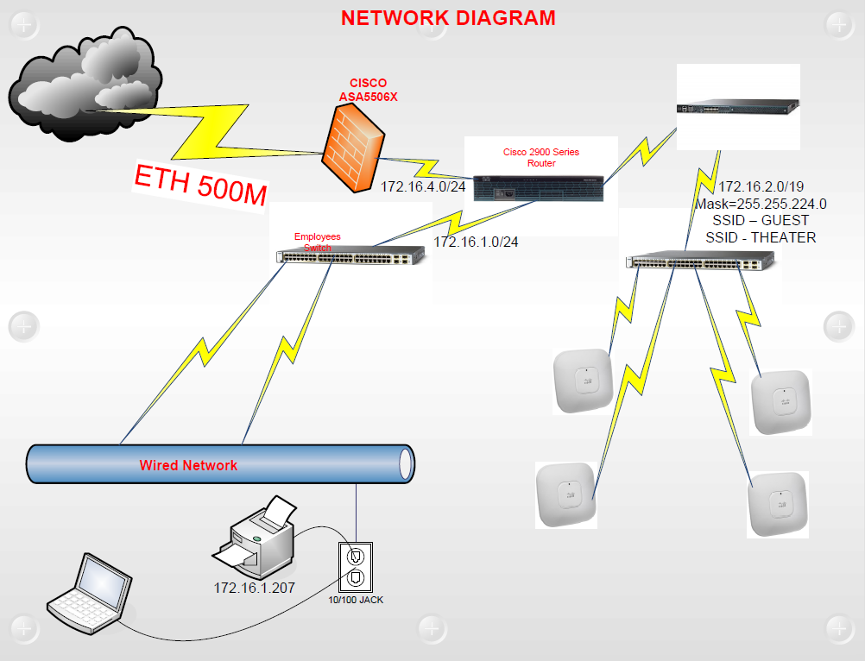
Infrastructure: Network Example
Illustrative

Slide 41
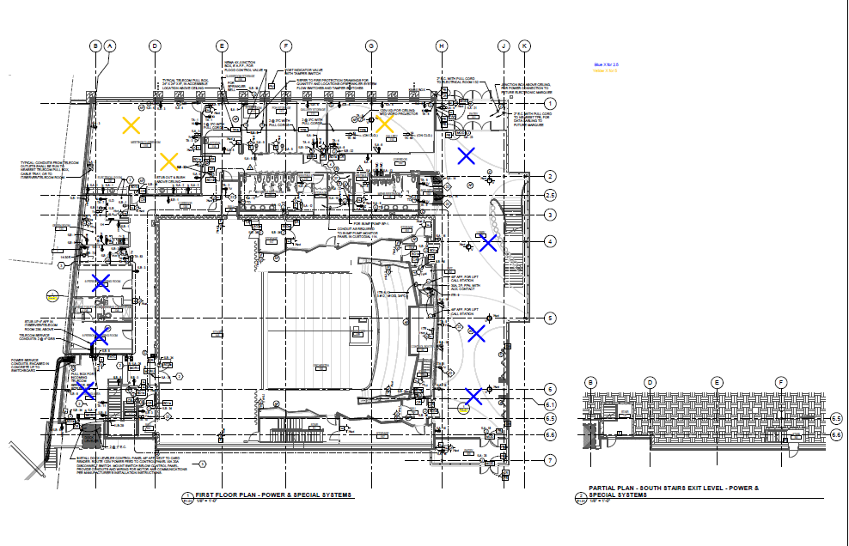
Infrastructure: AP Placement – First Floor
Illustrative

Slide 42
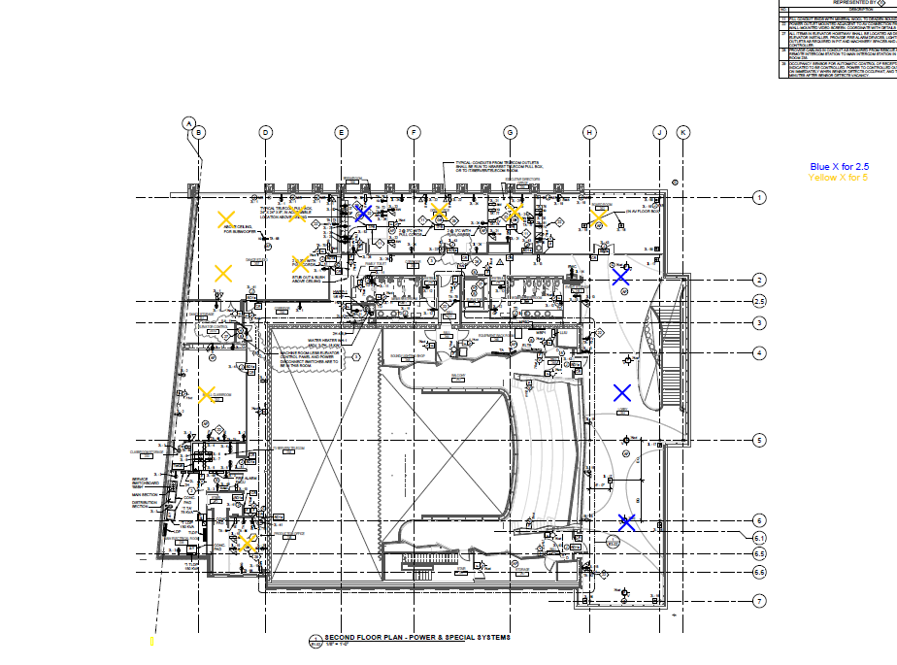
Infrastructure: AP Placement – Second Floor
Illustrative

